Slide 1
CropSWAP Program
Regional Program Update

Slide 2
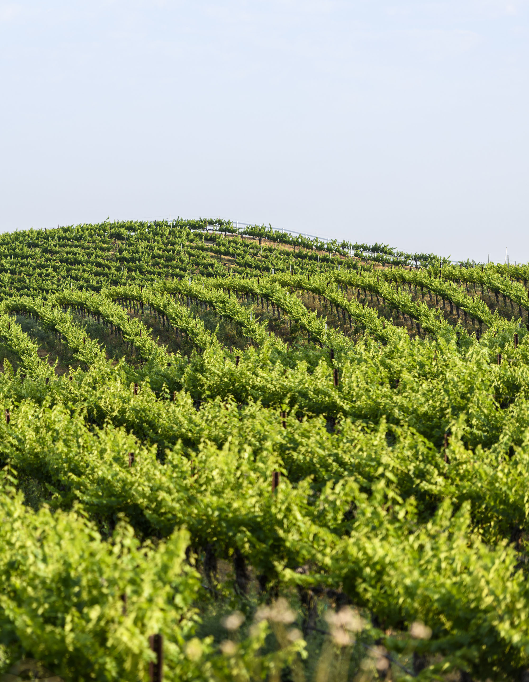
Crop SWAP Program
Program launched on April 29 with Regional Partners:
City of Escondido, FPUD, City of Oceanside, Rancho Water, and Valley Center
35 Project Applications by Rainbow Customers submitted through early June
Plan to continue Regional Program marketing campaign
Highlight in the July newsletter for Smart Irrigation Month and August 1 - 7 for National Farmers Week
Collaborate with Rancho Water on marketing best practices
12 projects already approved totaling $236,000 in reserved grant funding for Rainbow Ag customers!
Notes:
Regional CropSWAP Program launched on April 29 and a total of 35 applications have been submitted by Rainbow Water customers.
Push best management practice information out with Rancho Water
Rainbow Water is leading in largest participation among the Regional Partners.
A campaign to inform customers included: direct mail postcard to all agriculture customers over 1 acre; email to customers on interest list; letter mailed to interest list; press release in Village News; website page; and May newsletter article.
Rancho Water’s project administrators reached out to ask about promotional efforts and to share the info with the Regional Partners as best practices for campaign launch.
Add content to the website with link to Regional CropSWAP website
Second mailing with details on programs available

Slide 3
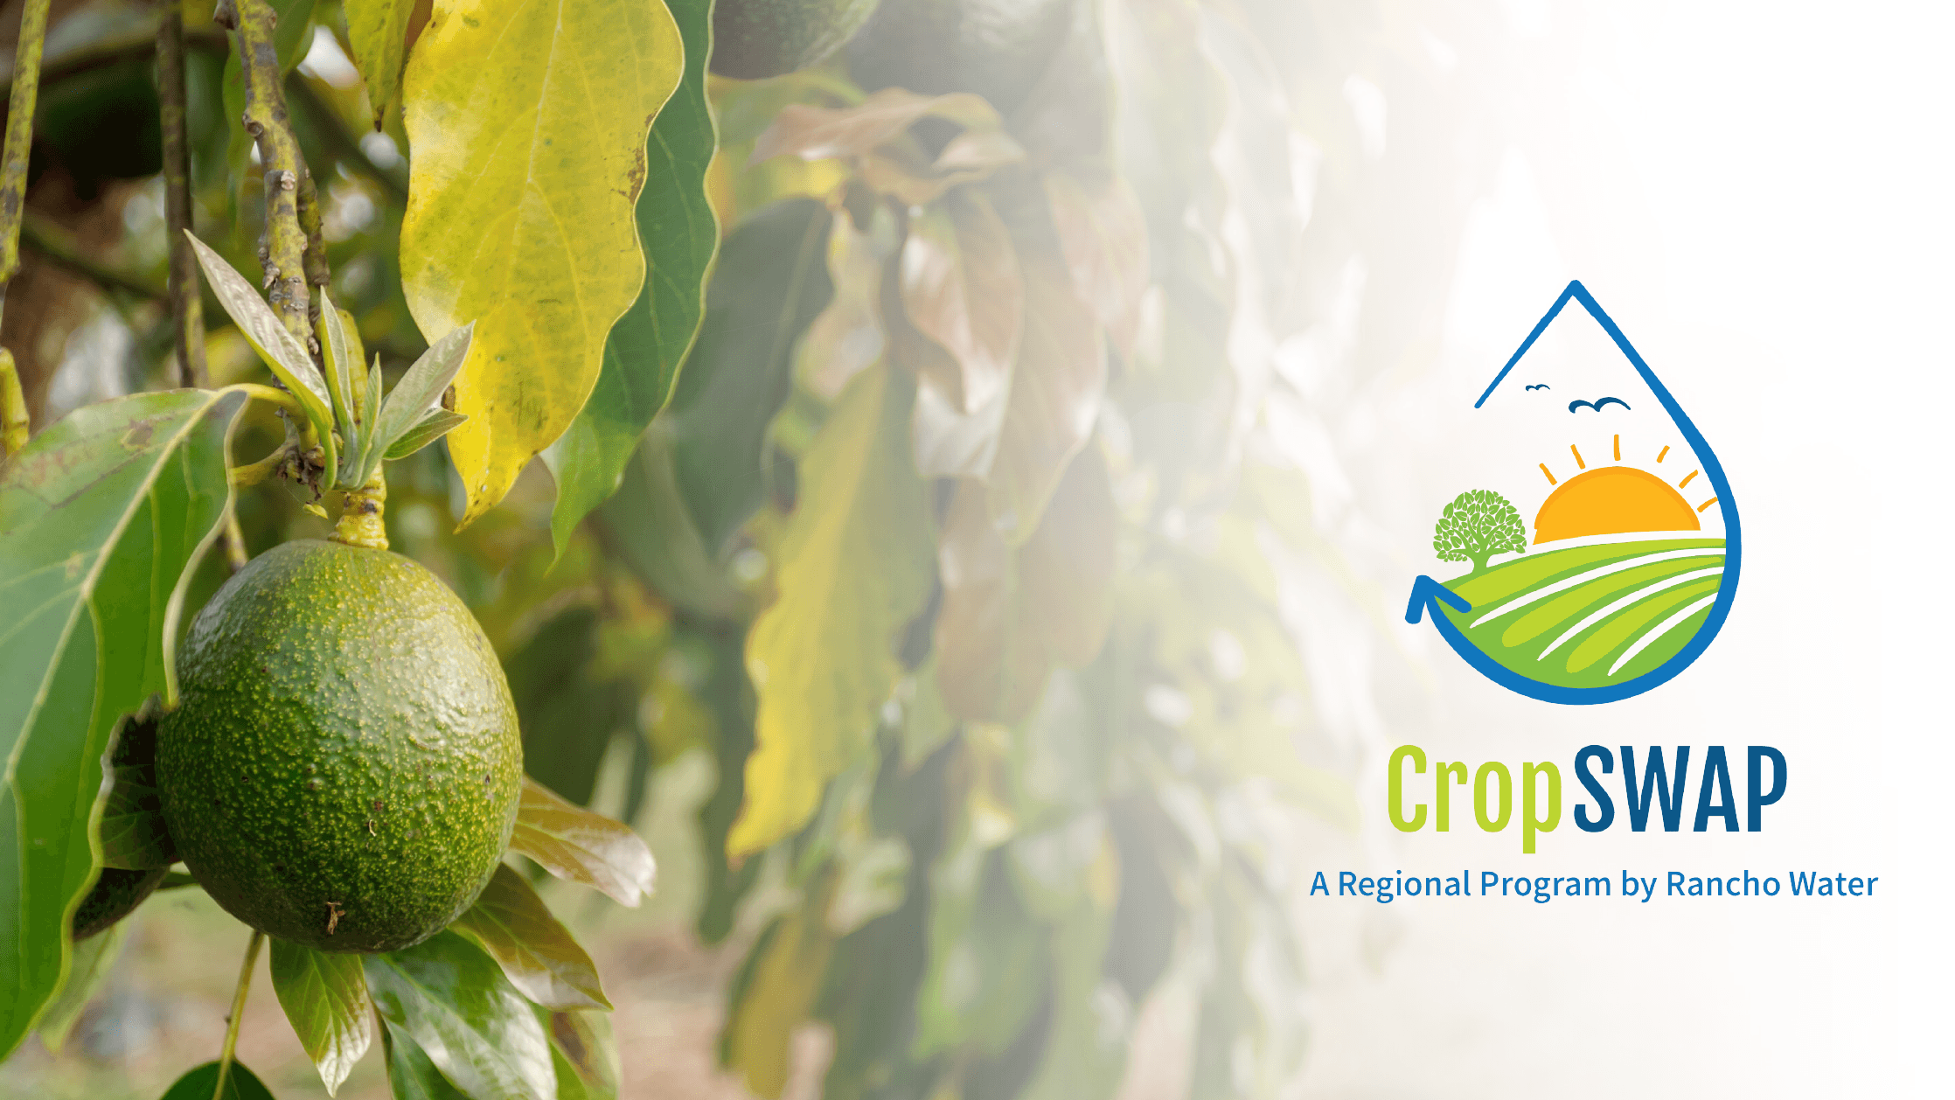
35 Program Submissions
15
Interest List
20
Direct Mail & Newsletter
12
Projects Approved
11
Pre-Inspection
11
Submissions Received
Notes:
Right now, if the current number of applicants are approved, Rainbow will exceed their allotted $200k budget and start to dip into the shared funding pool.
Rainbow Water exceed the allotted $200k budget and begin to use the shared funding pool.
The top applications by project type: avocado rootstock, crop rejuvenation, and crop conversion.

Slide 4
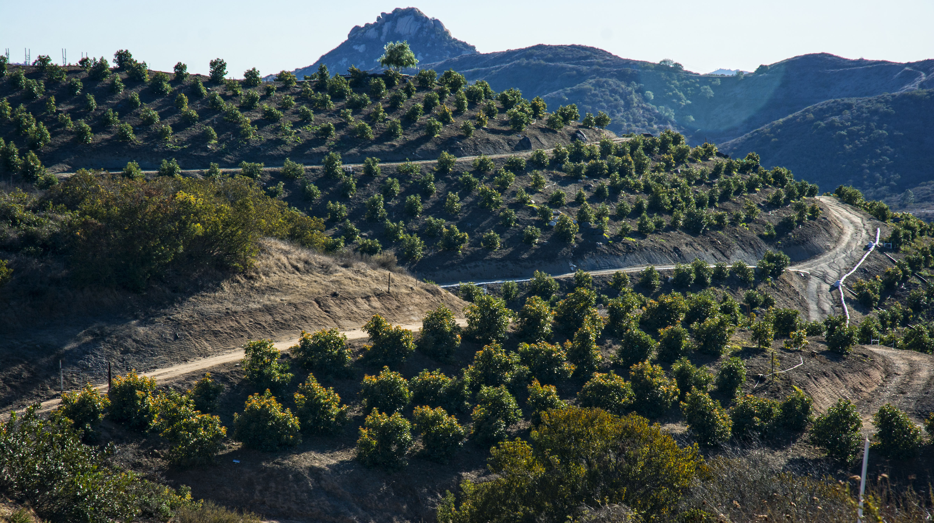
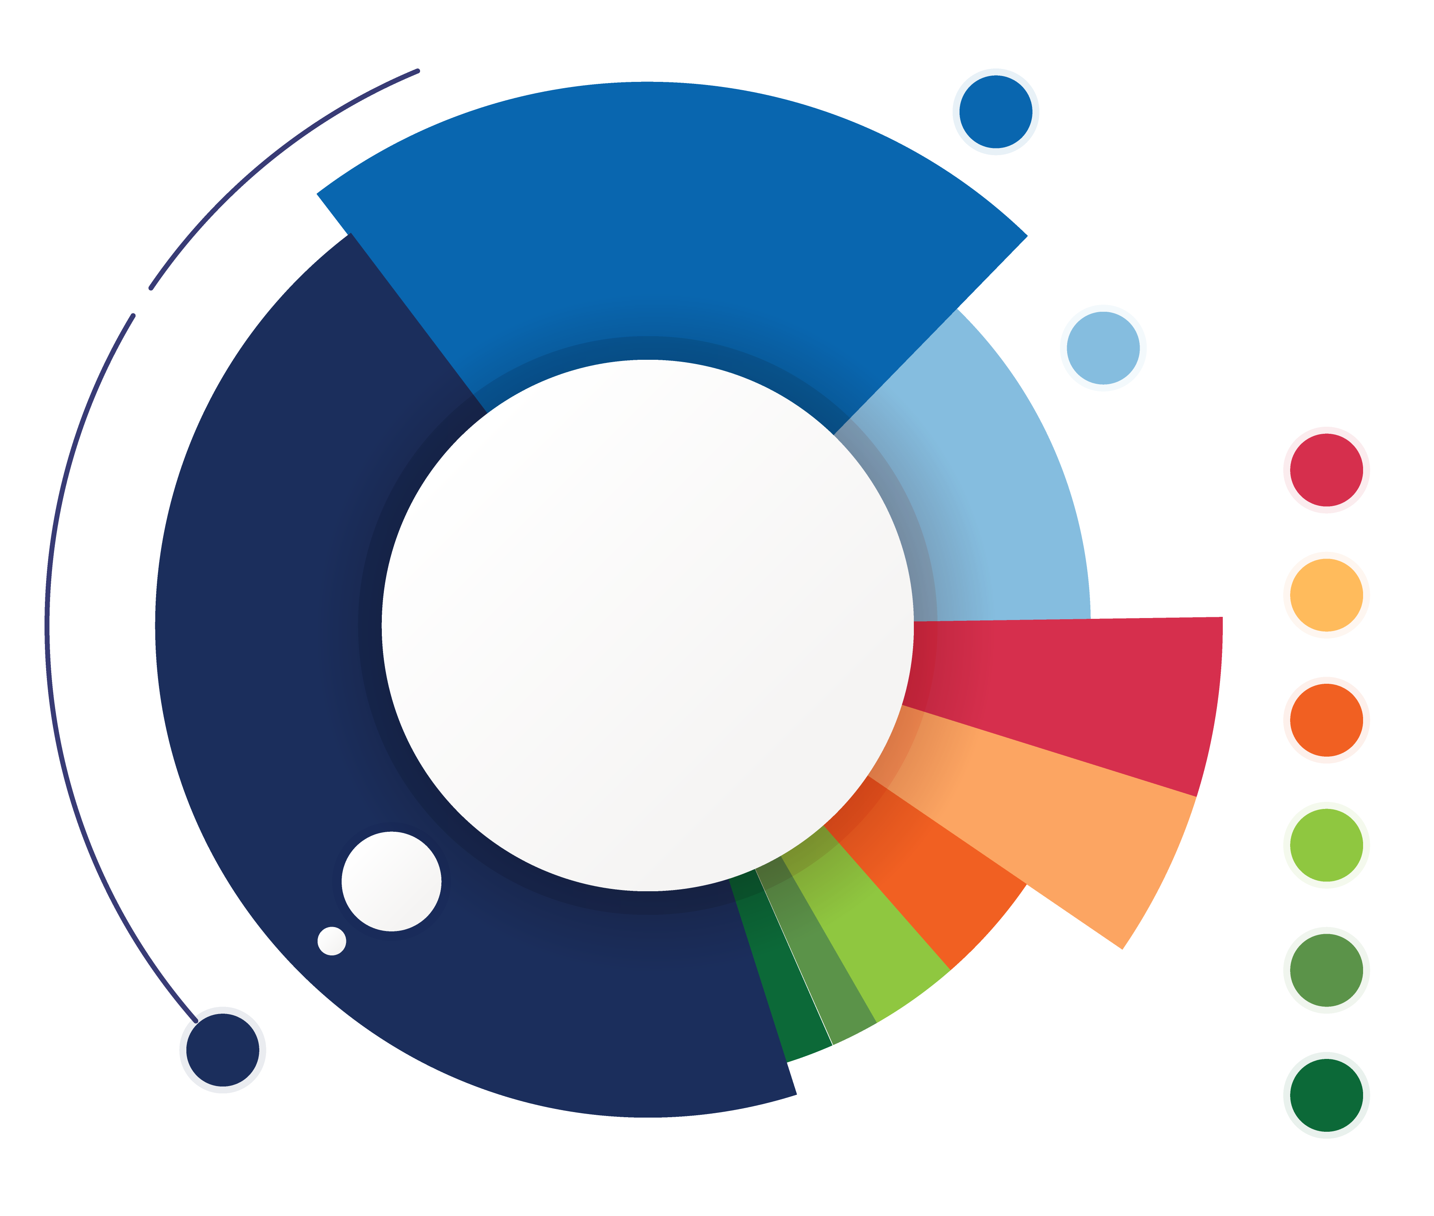
Applications by Project Type
7
Crop Conversion
4
Avocado Rejuvenation
3
Uniformity Improvements
3
Soil Moisture Sensors
2
Scheduling Automation
2
Mulching
1
Nutrient Management
1
Cover Crops
12
Avocado Rootstock
Notes:
As of June 2024, Rainbow had a total of 35 applications submitted. Currently the following project types have been submitted for review. Avocado Rootstock, Crop Conversion and Avocado Rejuvenation are the top performing categories.

