Slide 1
West Lilac, Rancho Amigos, Dentro De Lomas Pump Stations Project
RMWD Board of Directors Meeting
January 23, 2024

Slide 2
PUMP STATION LOCATIONS (DIVISION 1)
WEST LILAC PUMP STATION
7220 West Lilac Road, Bonsall
Ocean Breeze Ranch (near Sullivan Middle School)
RANCHO AMIGOS PUMP STATION
31267 Rancho Amigos, Bonsall
EWM Investments (Earnest Moody’s Vineyard)
DENTRO DE LOMAS PUMP STATION
1990 Dentro De Lomas, Bonsall
Bonsall Oaks Development

Slide 3
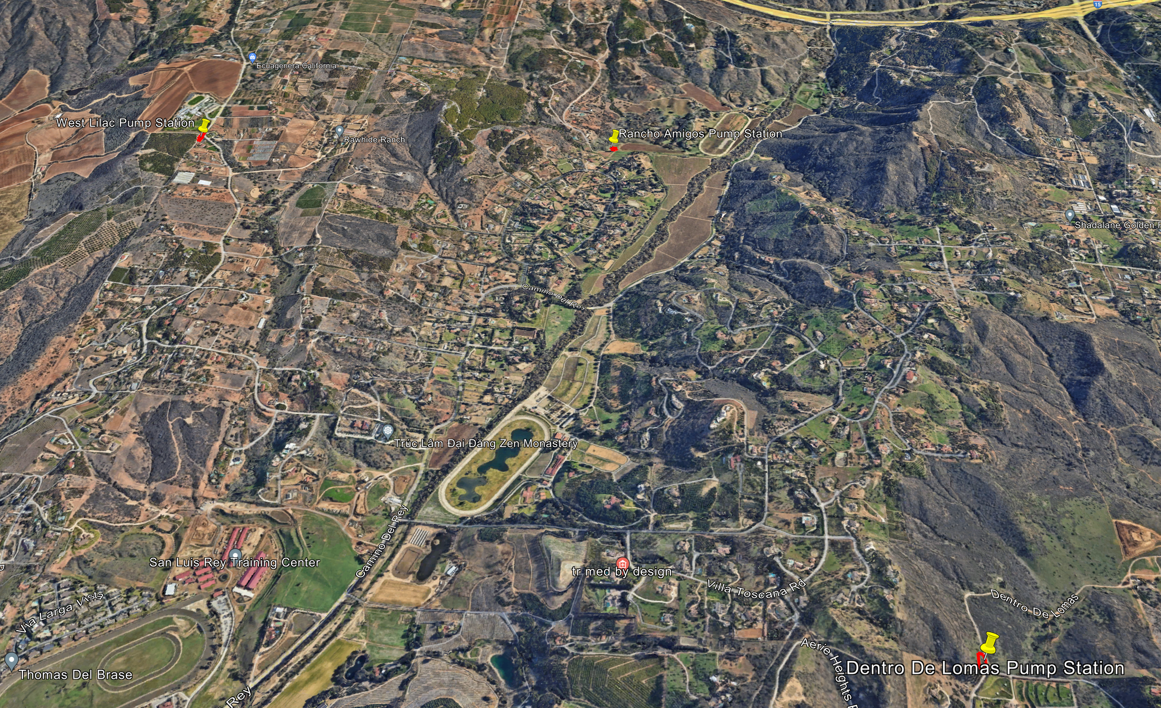

Slide 4
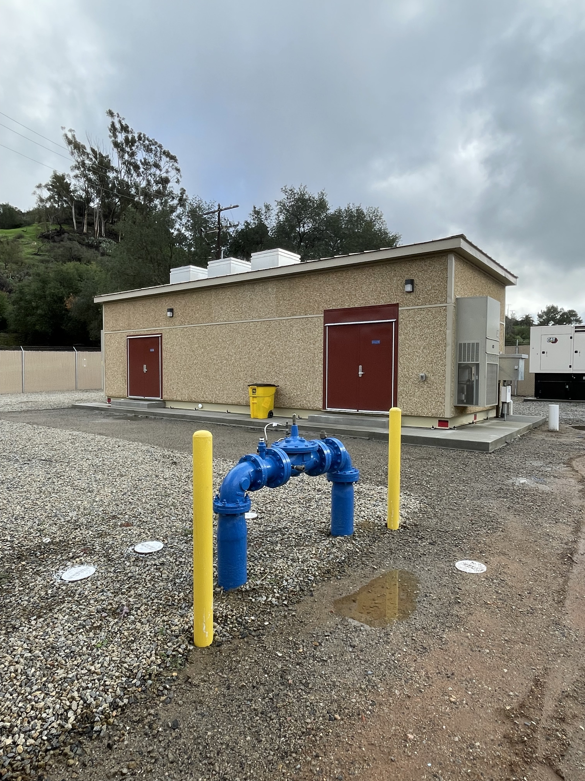
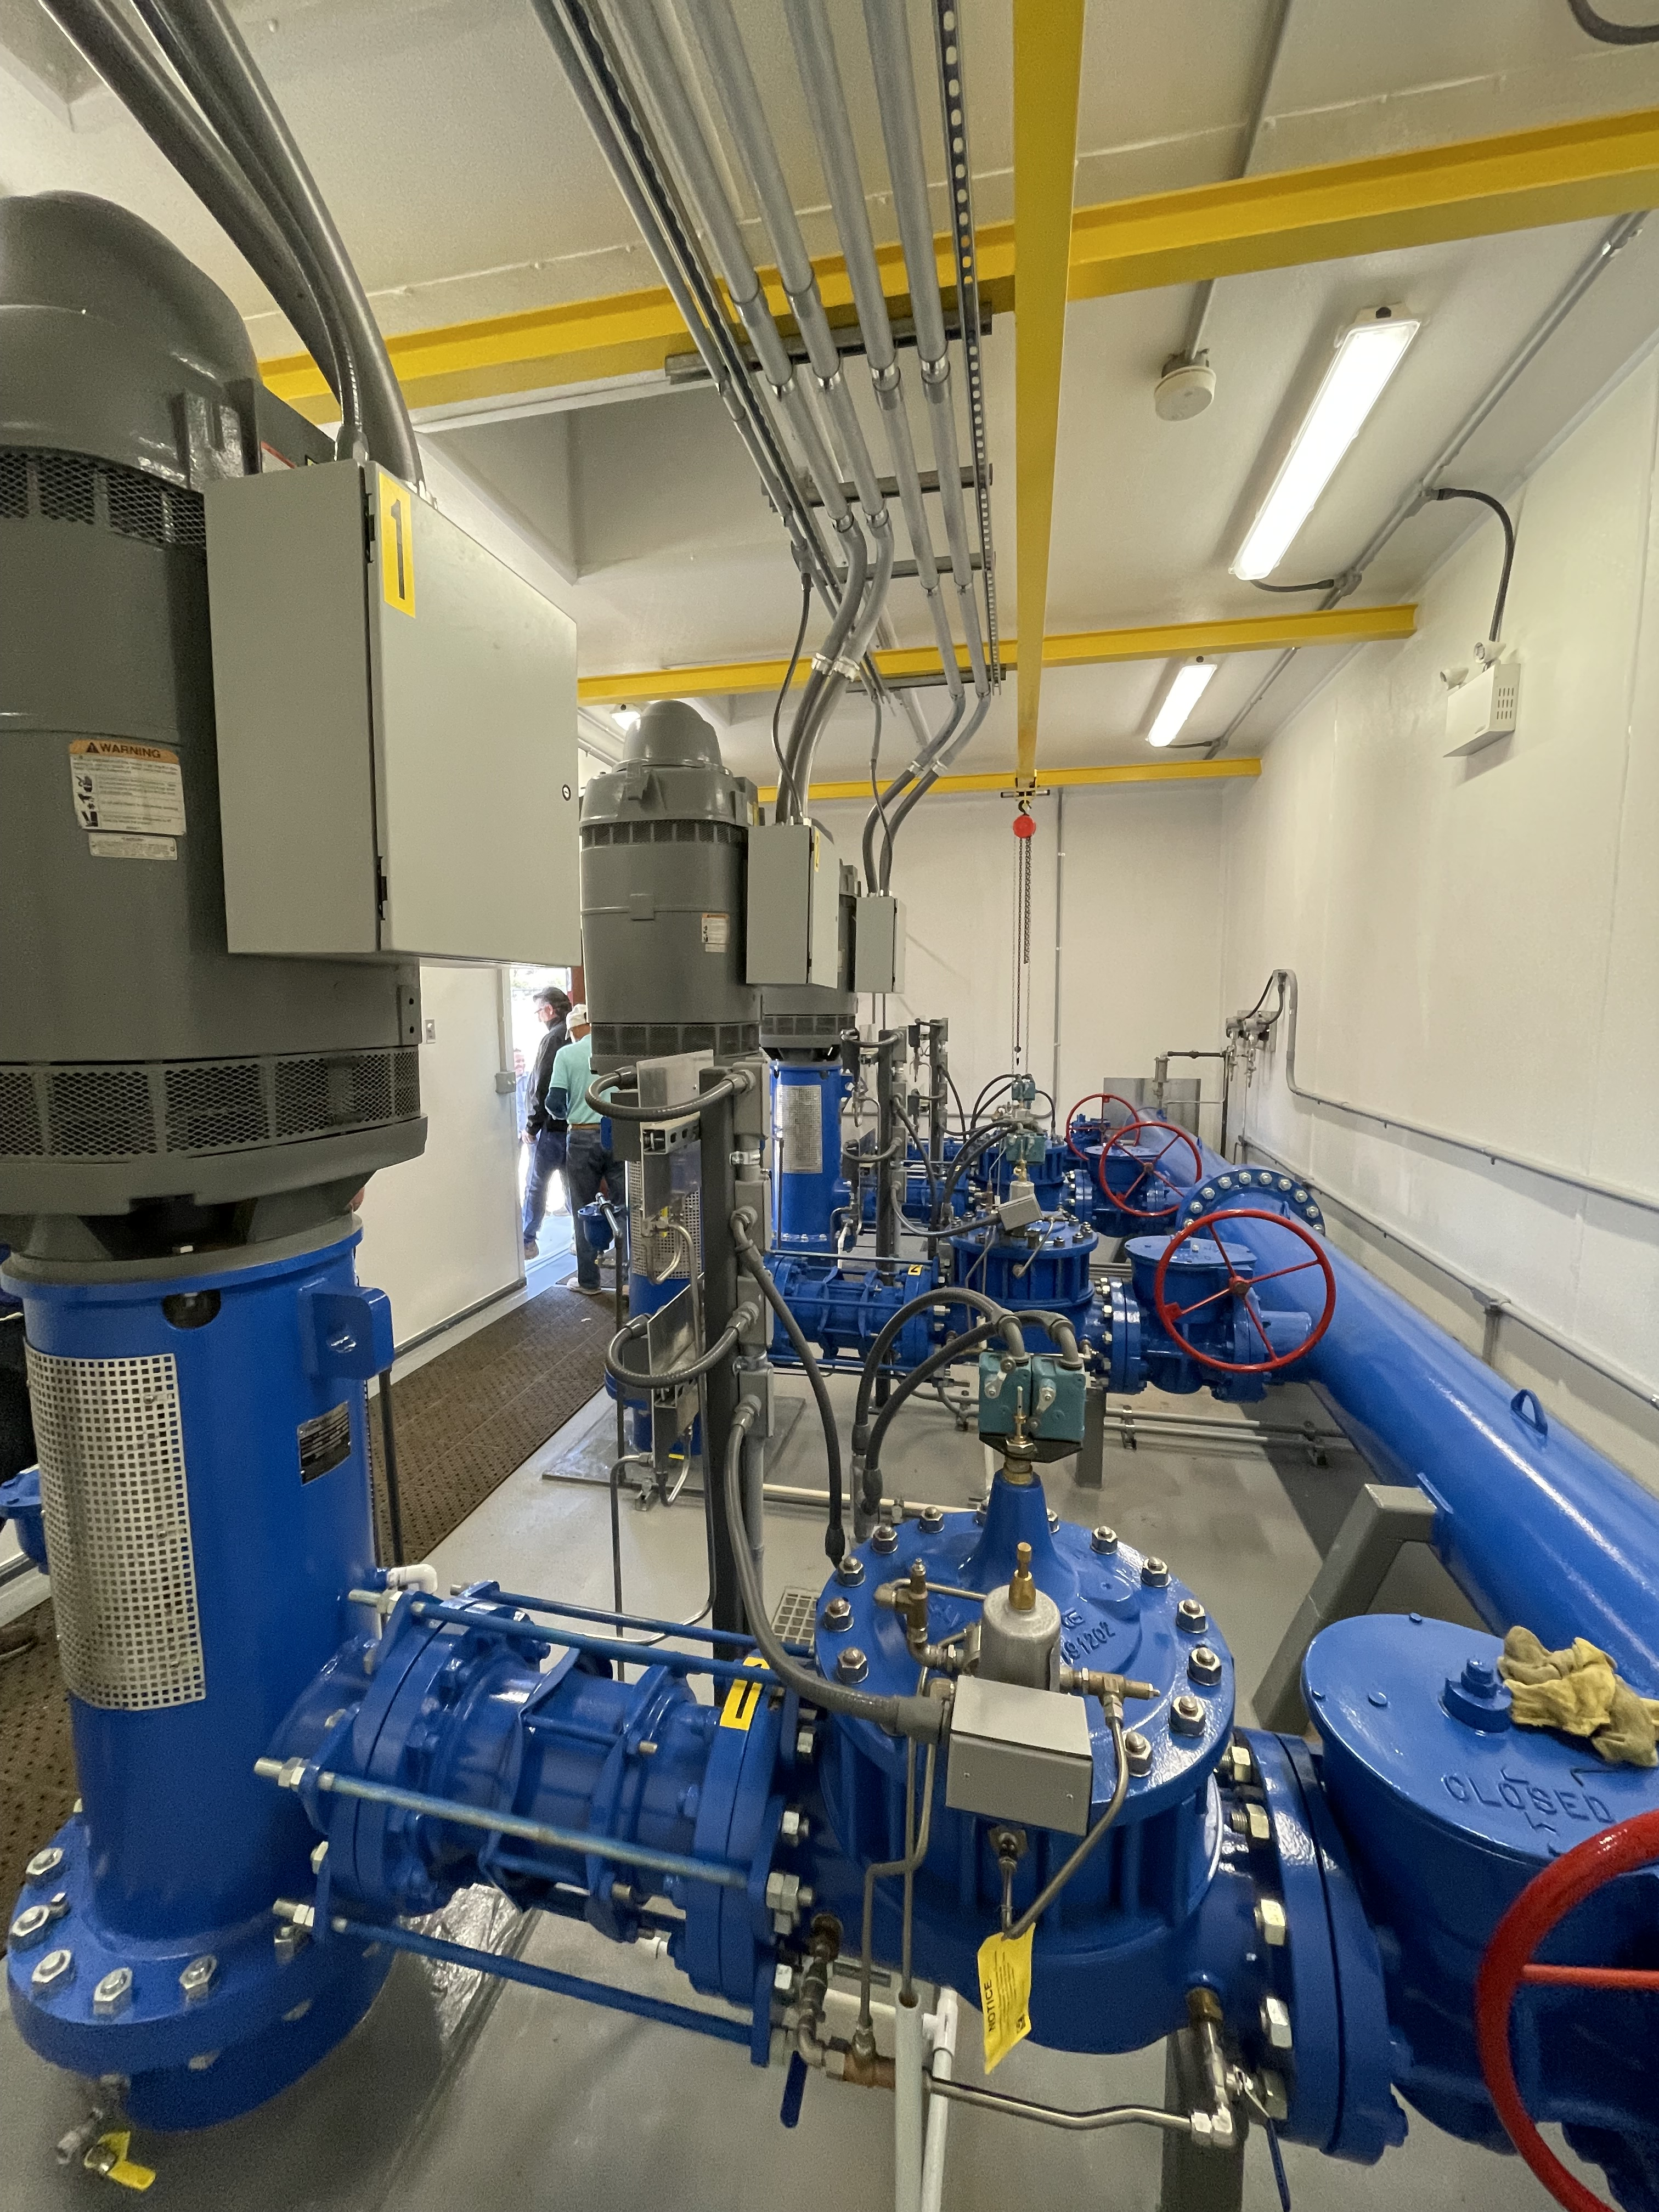
RAINBOW HEIGHTS PUMP STATION PREFABRICATED PUMP STATION
PUMP STATION EXAMPLE:

Slide 5
APPROVED BUDGET

Slide 6
PRELIMINARY MIDYEAR BUDGET UPDATE

Slide 7
Construction Management (CM) Consultant Ranking
RANK | FIRM | NOT TO EXCEED FEE
1 | Valley Construction Management | $ 110,480
2 | Arcadis | $ 477,810
3 | Acrostic Construction Management | $ 480,000
4 | MKN & Associates | $ 100,084
5 | PdM Consulting, Inc. | $ 325,280
6 | JGM | $ 895,550
7 | Hoch Consulting* | $ 408,537
*Per Government Code 1090, firm is disqualified from selection as they are the Engineer of Record for the project

Slide 8
SCHEDULE
BOARD AWARD CONSTRUCTION CONTRACT-12/19/2023
PACIFIC HYDROTECH CORPORATION-$5,657,500
CONTRACT EXECUTED-01/09/2024
BOARD AWARD CM AGREEMENT (Tentative) -01/23/2024
VALLEY CONSTRUCTION MANAGEMENT-$110,480
PRE-CONSTRUCTION MEETING-01/31/2024
NOTICE TO PROCEED-02/07/2024
PUMP STATION DELIVERY-04/2024
CONSTRUCTION COMPLETION (180 WDs)-10/2024

Slide 9
Questions?

