Slide 1
Communications & Customer Service
COMMITTEE MEETING
June 18, 2024

Slide 2
Agenda
Approval of Minutes
General Manager Comments
Committee Member Comments

Slide 3
CropSWAP Program

Slide 4
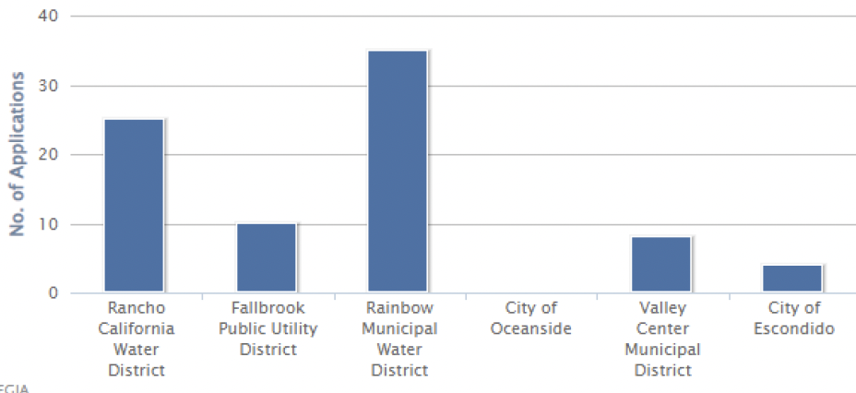
Crop SWAP Program
Program Launched with Rainbow Water leading applications
35 Applications submitted in May
Notes:
Regional CropSWAP Program launched on April 29 and a total of 35 applications have been submitted by Rainbow Water customers.
Push best management practice information out with Rancho Water
Rainbow Water is leading in largest participation among the Regional Partners.
A campaign to inform customers included: direct mail postcard to all agriculture customers over 1 acre; email to customers on interest list; letter mailed to interest list; press release in Village News; website page; and May newsletter article.
Currently projects are under review pending inspection and approval with Rancho Water’s project administrators.
Rainbow Water is set to exceed the allotted $200k budget and begin to use the shared funding pool.
The top applications by project type: avocado rootstock, crop rejuvenation, and crop conversion.

Slide 5
35 Program Submissions
15
Interest List
20
Direct Mail & Newsletter
12
Projects Approved
11
Pre-Inspection
11
Submissions Received
Notes:
Rainbow is by far leading the pack in terms of number of applicants. As of last week, Rainbow had a total of 8 applications submitted. Currently no project has been approved as they are going through the inspection process, but projects should start seeing approval within the week. Right now, if the current number of applicants are approved, Rainbow will exceed their allotted $200k budget and start to dip into the shared funding pool.

Slide 6
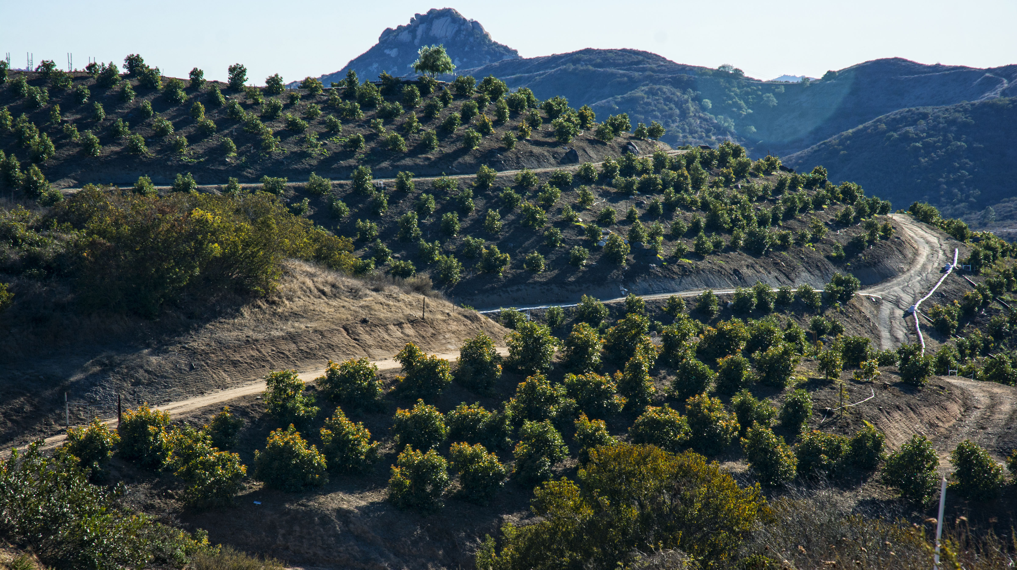
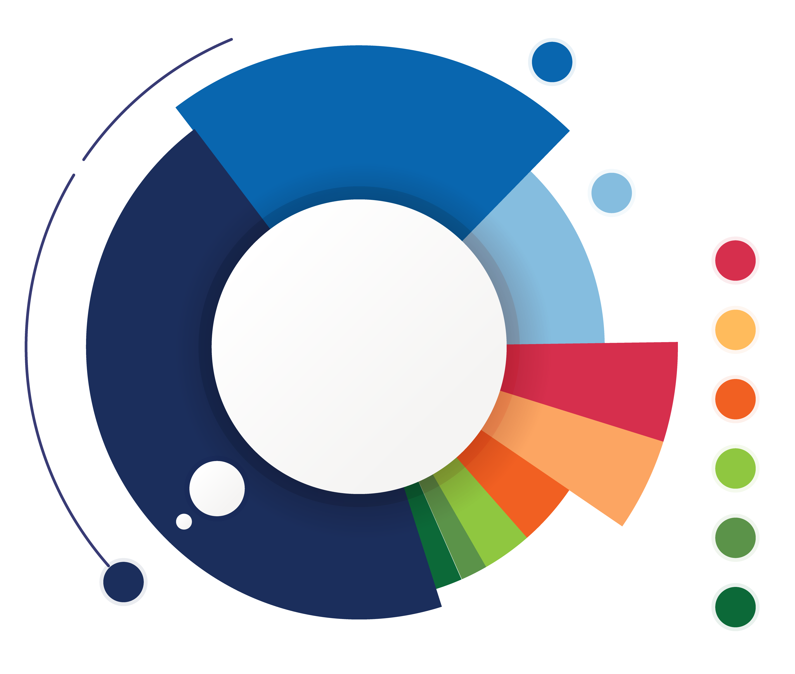
Applications by Project Type
7
Crop Conversion
4
Avocado Rejuvenation
3
Uniformity Improvements
3
Soil Moisture Sensors
2
Scheduling Automation
2
Mulching
1
Nutrient Management
1
Cover Crops
12
Avocado Rootstock
Notes:
Rainbow is by far leading the pack in terms of number of applicants. As of last week, Rainbow had a total of 8 applications submitted. Currently no project has been approved as they are going through the inspection process, but projects should start seeing approval within the week. Right now, if the current number of applicants are approved, Rainbow will exceed their allotted $200k budget and start to dip into the shared funding pool.

Slide 7
Community Events Update

Slide 8
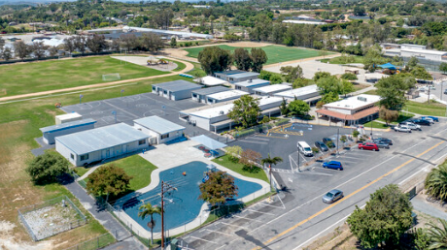
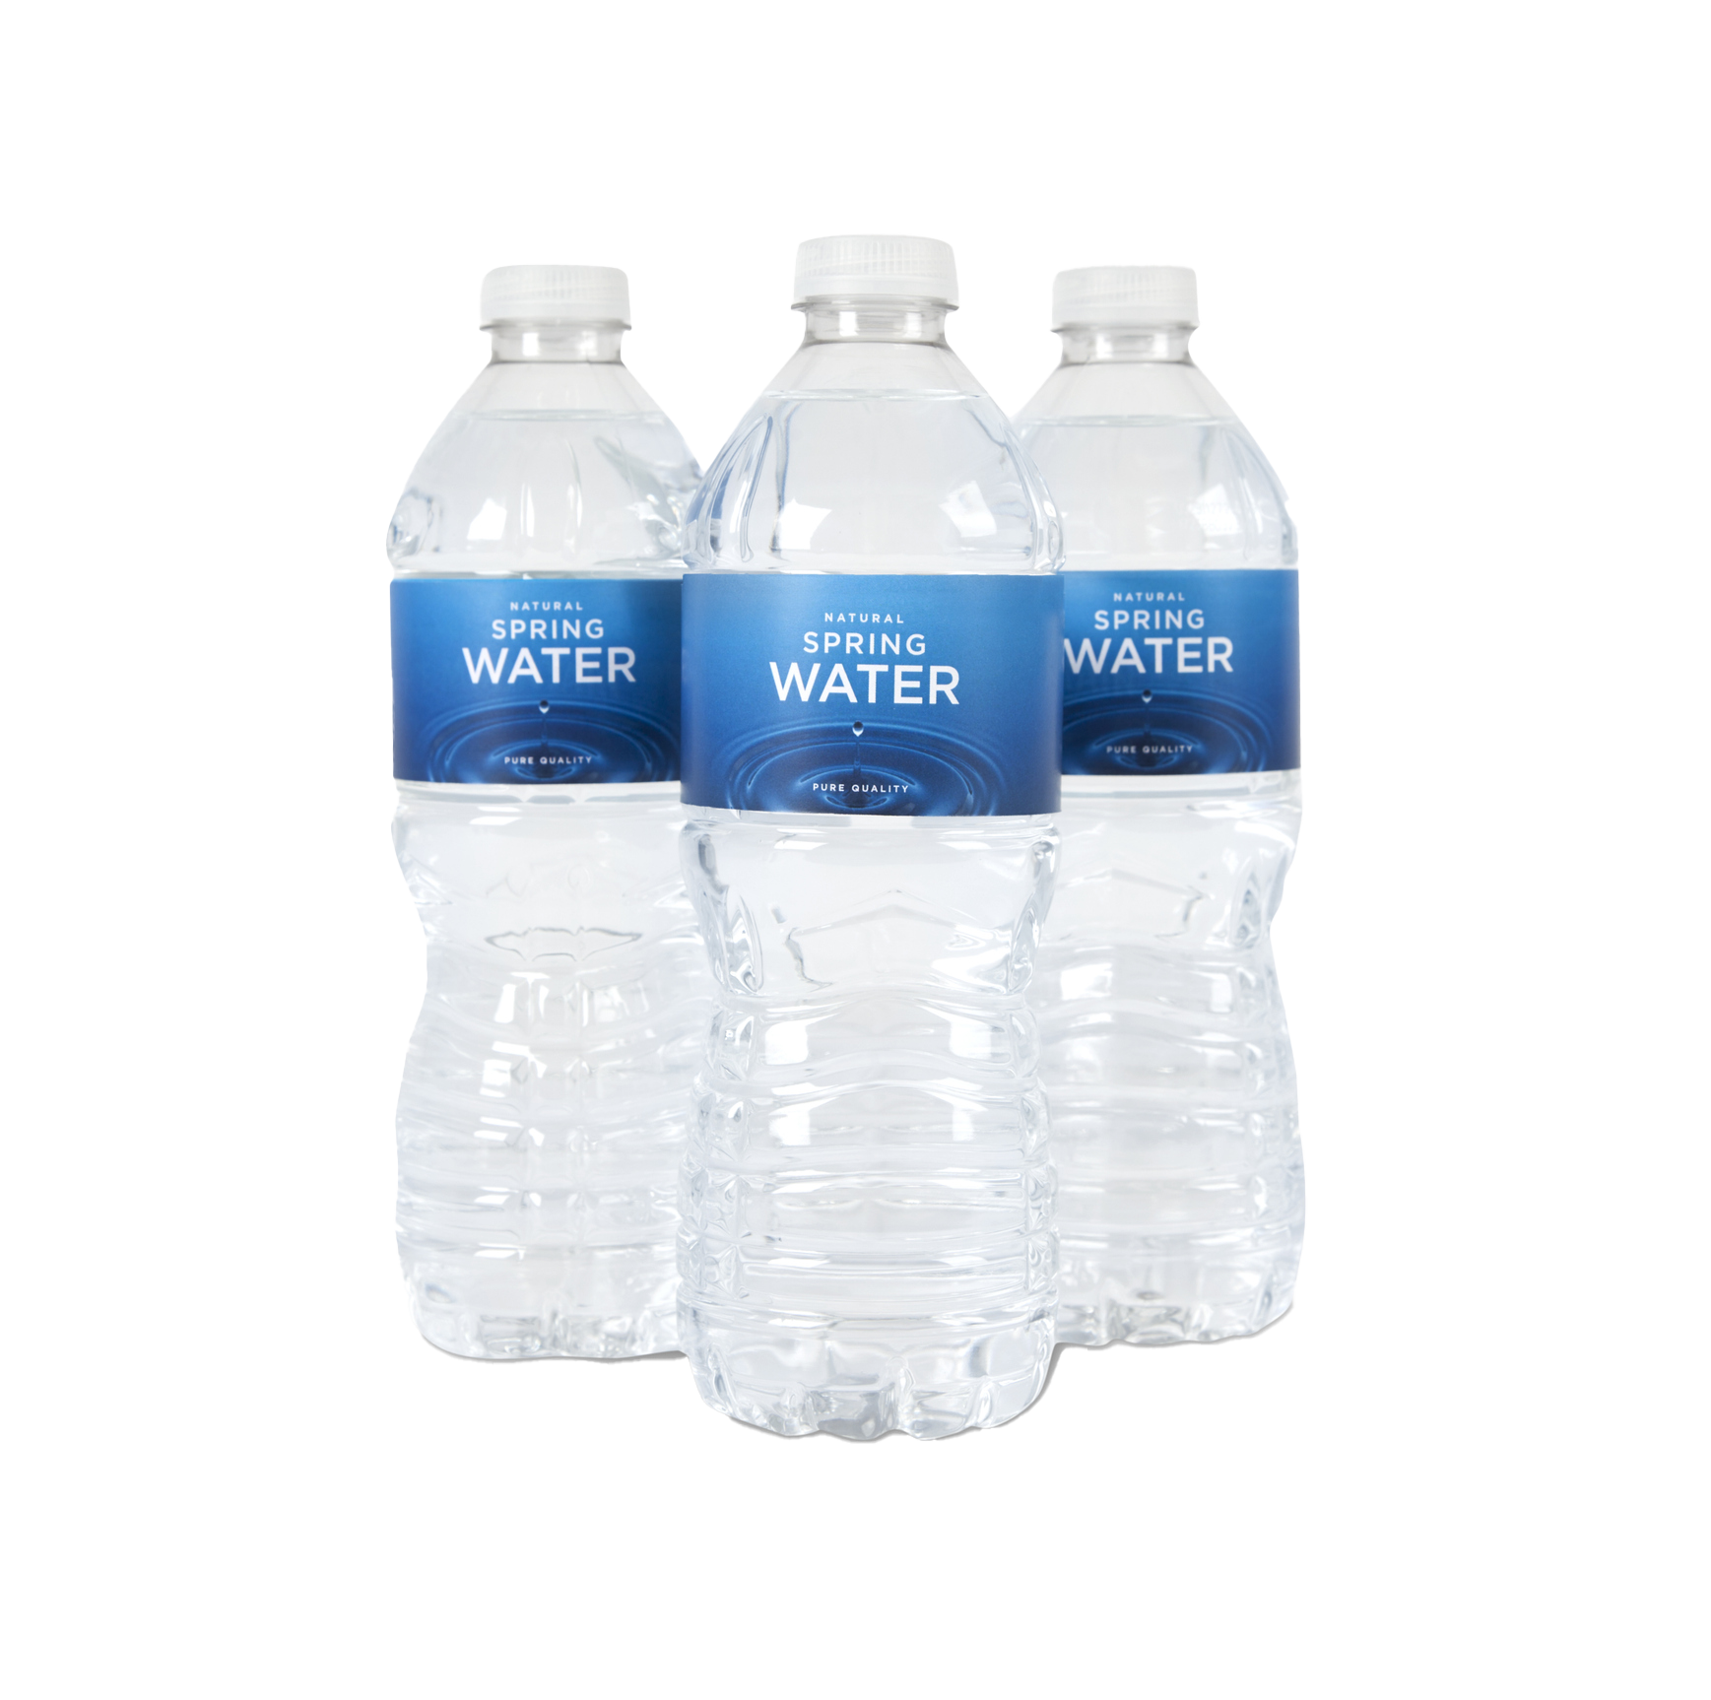
Rainbow Run
Saturday, June 15
Sponsored the water booth
3K Race with over 200 Runners and Walkers benefitted Vallecitos Elementary School
Notes:
At Vallecitos Elementary we are on a mission to encourage healthier habits in our students, families, and communities! During this fun event we hope to mix fun and movement with Rainbow and Fallbrook community vendors.
https://raceroster.com/events/2024/86799/first-annual-rainbow-run
Promo Code: WATER24

Slide 9
Newsletter Content Planning

Slide 10
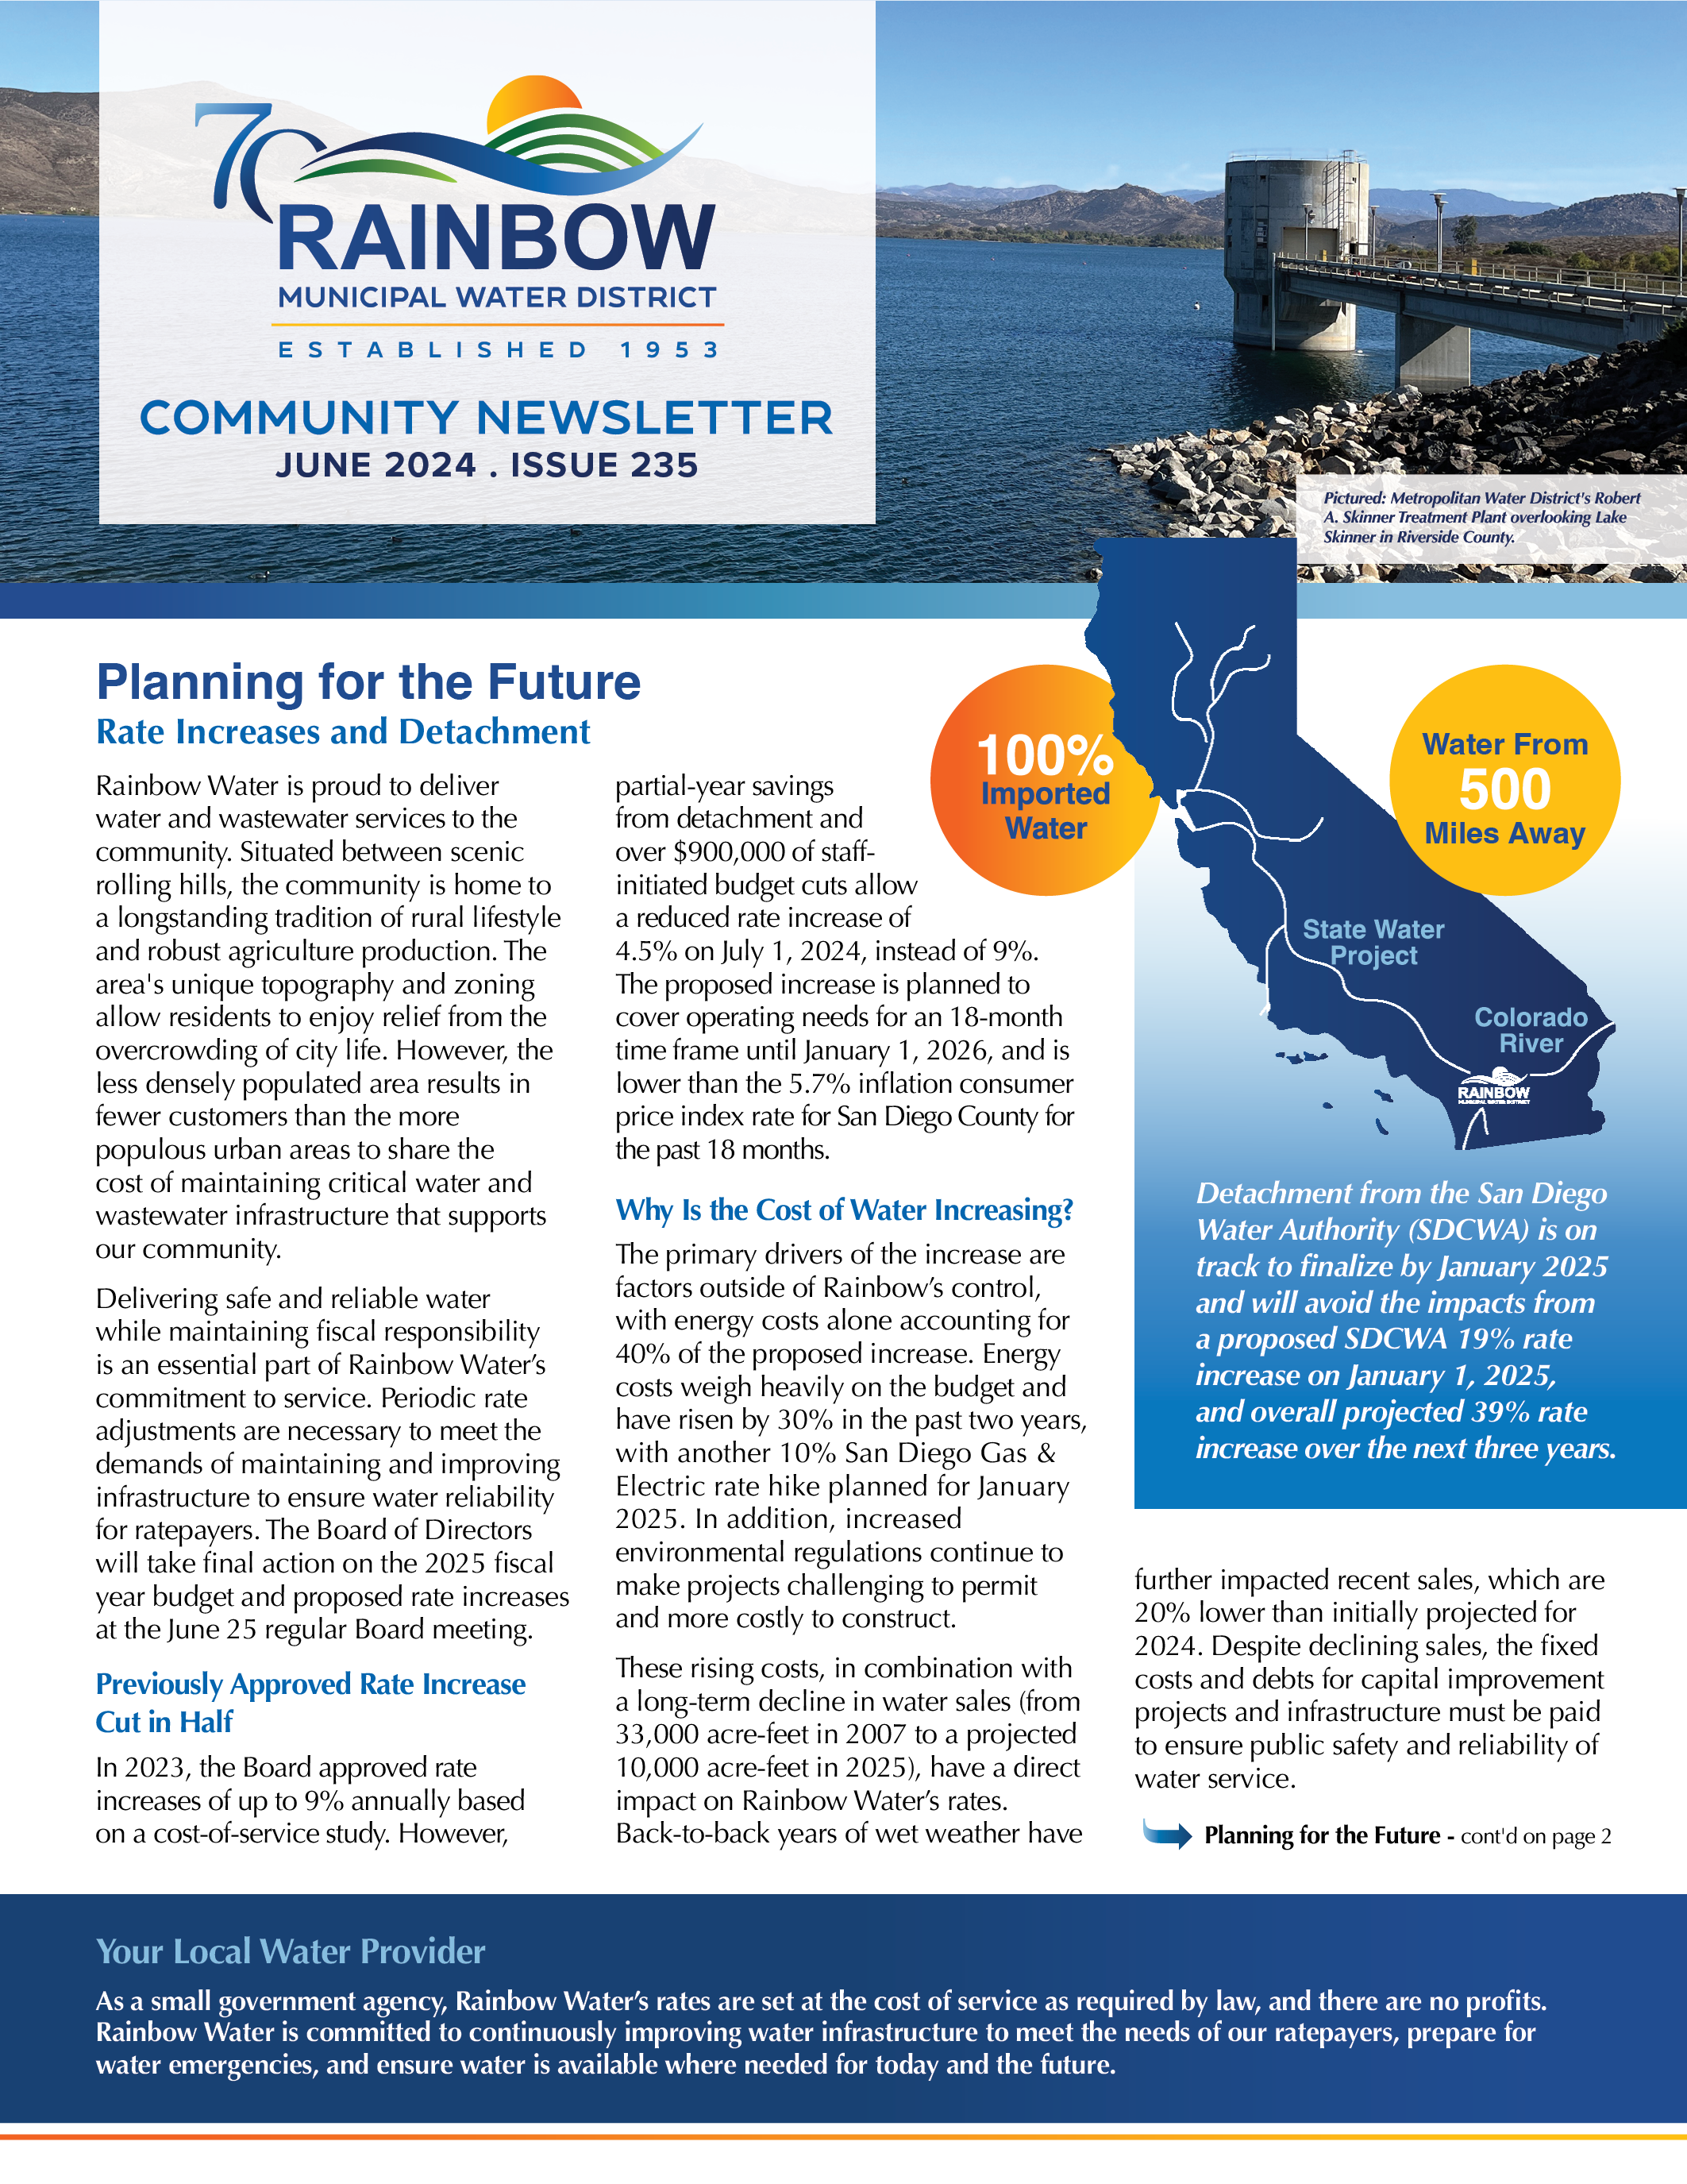
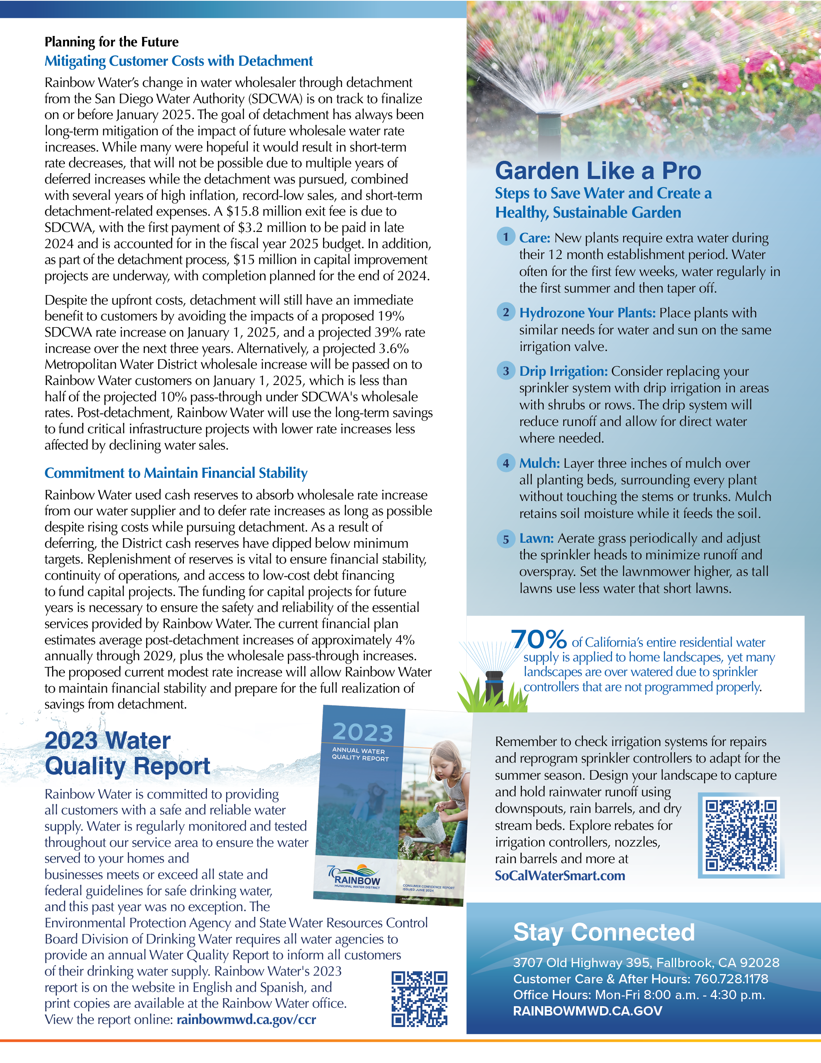
Newsletter Review
May
Planning for the Future
Rate increases and detachment update with detail on financial planning and the rising cost of water.
2023 Water Quality Report
Annual water quality report to inform customers of their drinking water supply with link to the English and Spanish digital brochure.
Garden Like a Pro:
Continue the series with five more tips to create a sustainable garden with link to rebates and resources on Metropolitan’s SoCal WaterSmart website.

Slide 11
Newsletter Planning
July
Smart Irrigation Month
Highlight the CropSWAP Program’s irrigation efficiency upgrades
Smart flow devices: Flume program with instant rebate
Tips for adjusting water for heat
Convert to a Sustainable Landscape with Rebates
Guide to removing turf & sheet mulching with video links
Summer Water Guide
Tips for adjusting water for heat
Share Your Experience
Take the customer service survey
August
Value of Water
Explain how price of water pays for components of infrastructure, maintenance, and more to deliver safe reliable water
Infographic feature
Backflow Device Review
Tips for identifying your needs and service
Video overview
Share Your Experience
Take the customer service survey
Notes:
CropSWAP Enhance water efficiency on one or more irrigated acres through equipment upgrades such as soil moisture sensors, best management practices with mulching and cover crops.

Slide 12
Public Communications
& Related Media Stories

Slide 13
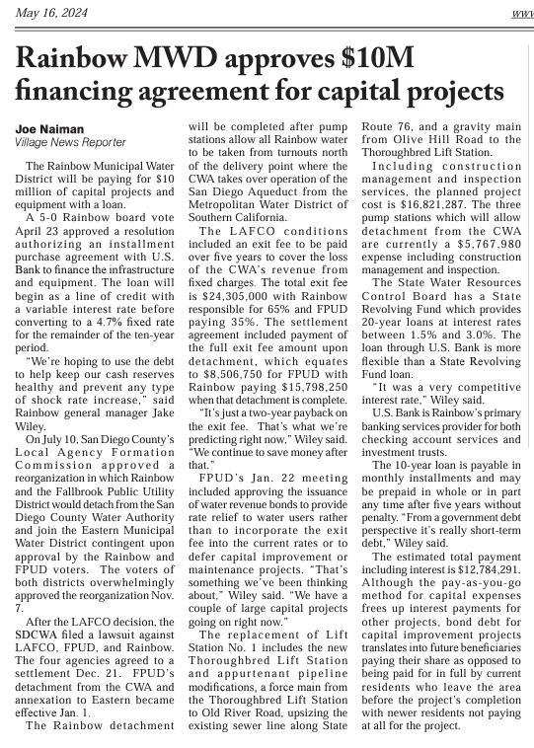
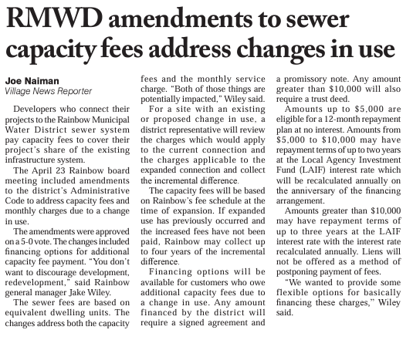
Village News
May 18
Rainbow MWD approves $10M financing agreement for CIP
May 18
Rainbow MWD amendments to sewer capacity fees address changes in use

Slide 14
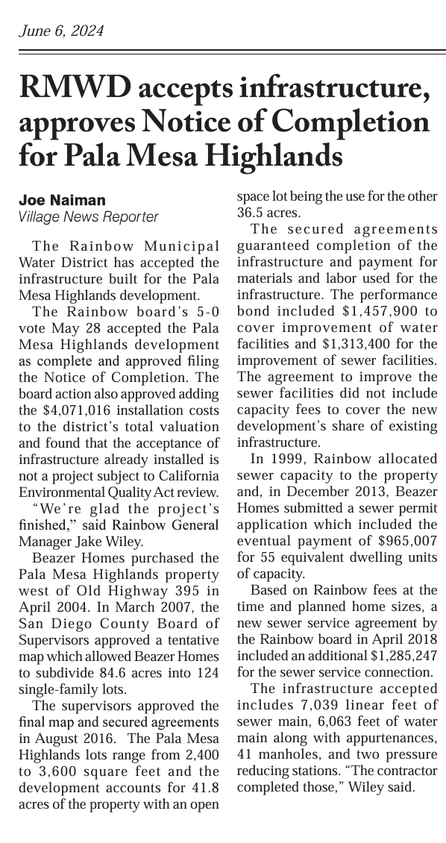
Village News
June 6
RMWD accepts infrastructure, approves Notice of Completion for Pala Mesa Highlands

Slide 15
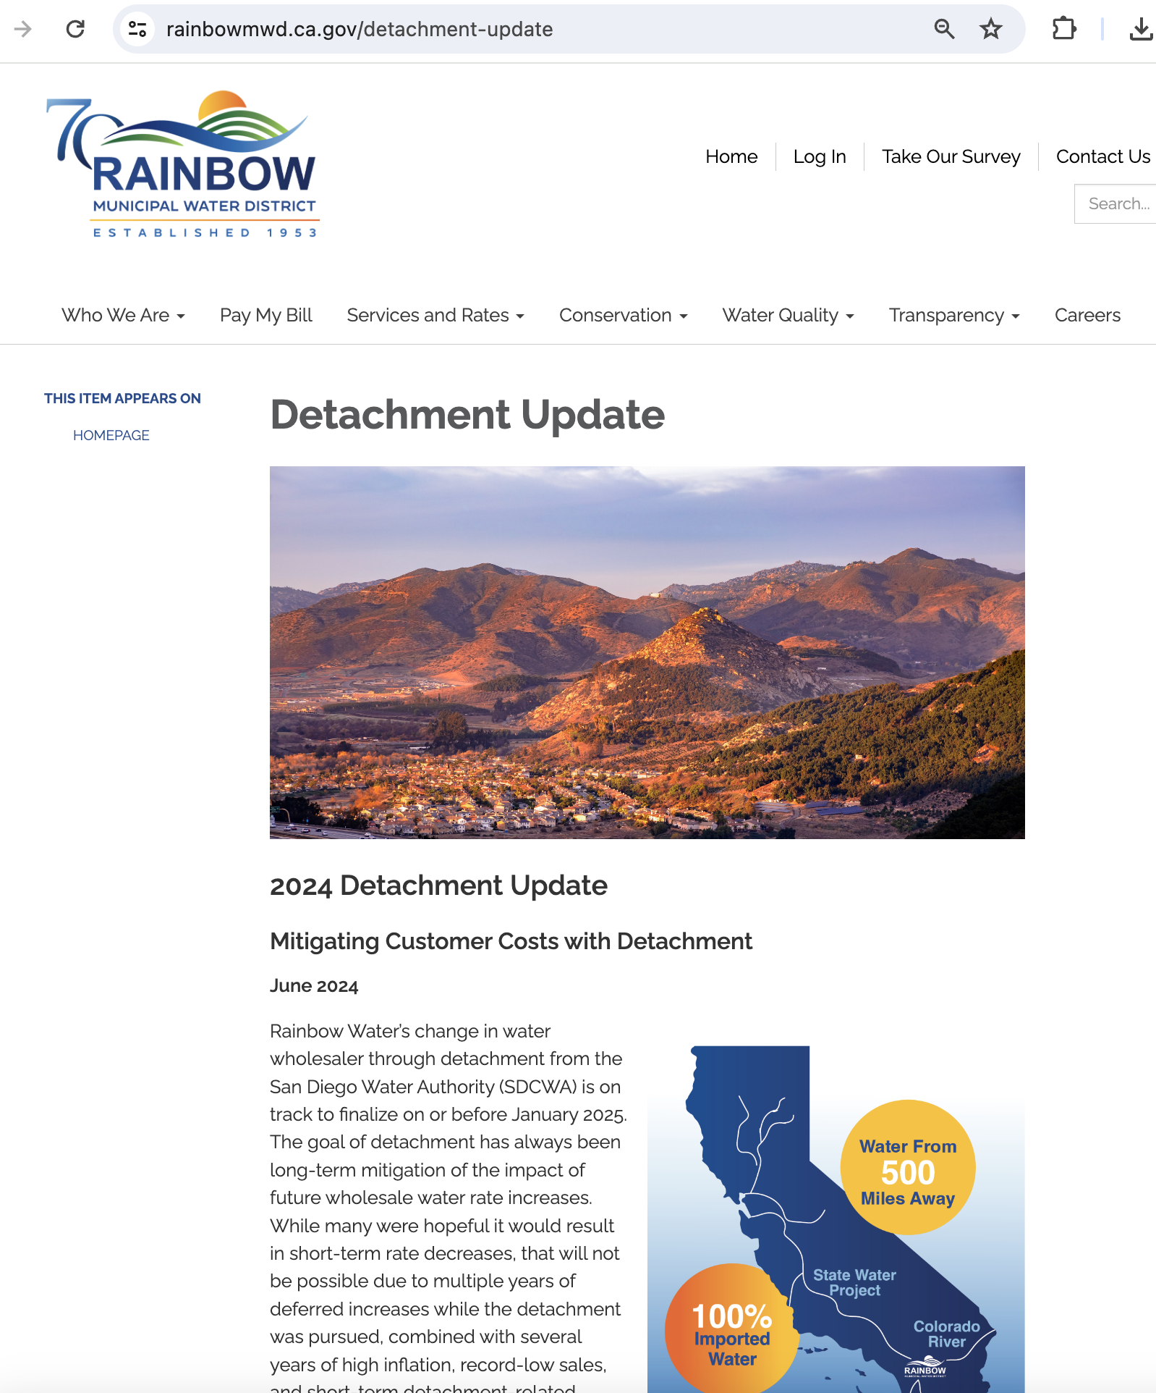
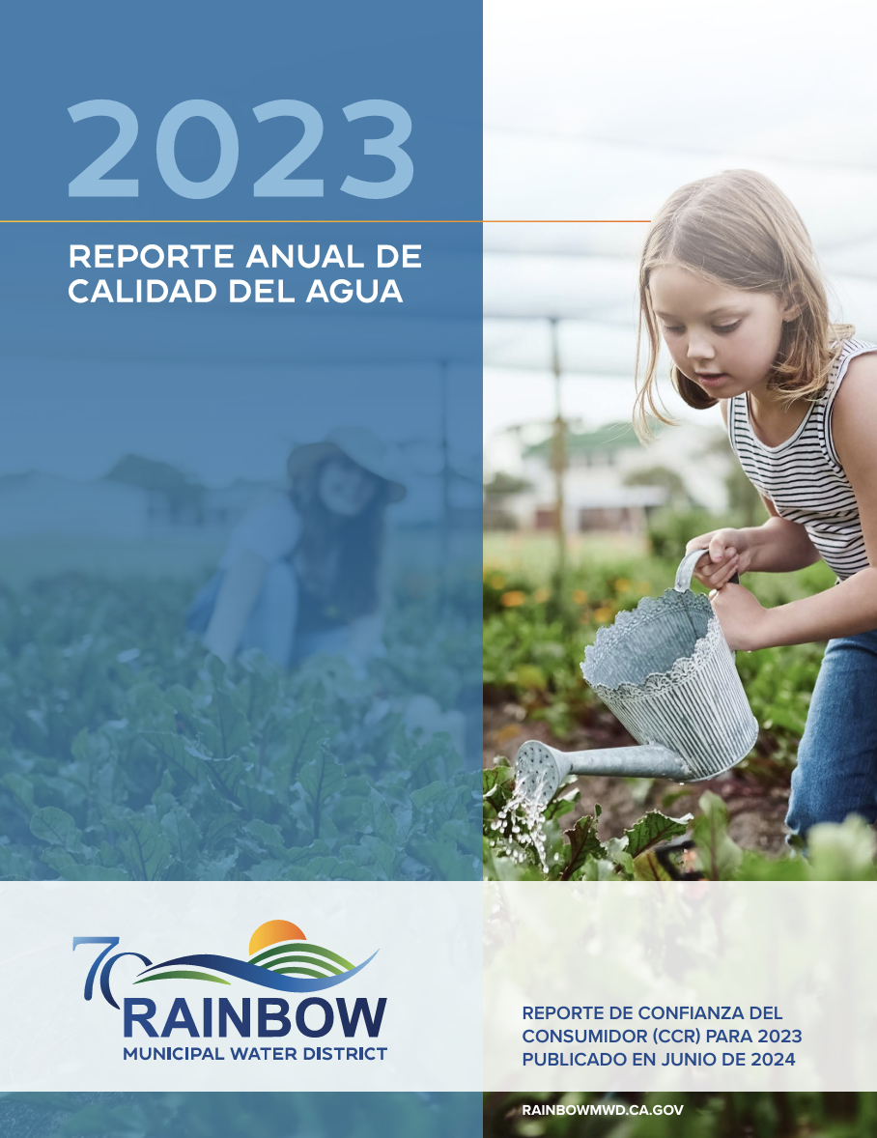
Website & Collateral
Water Quality Report
English and Spanish versions of the 2023 CCR are available in the lobby and for download on the website
Detachment Update
Content from newsletter updated on the detachment page

Slide 16
Agenda Items for Next Meeting July 23, 2024

