Slide 1
Communications & Customer Service
COMMITTEE MEETING
May 21, 2024

Slide 2
Agenda
Approval of Minutes
General Manager Comments
Committee Member Comments

Slide 3
Customer Service Metrics
Quarterly Report

Slide 4
Average Hold Time

Slide 5
Monthly Calls

Slide 6
Average Talk Time

Slide 7
Average Hold Time in Minutes
2023 vs 2024

Slide 8
Average Monthly Calls
2023 vs 2024

Slide 9
Average Talk Time
2023 vs 2024

Slide 10
CropSWAP Program

Slide 11
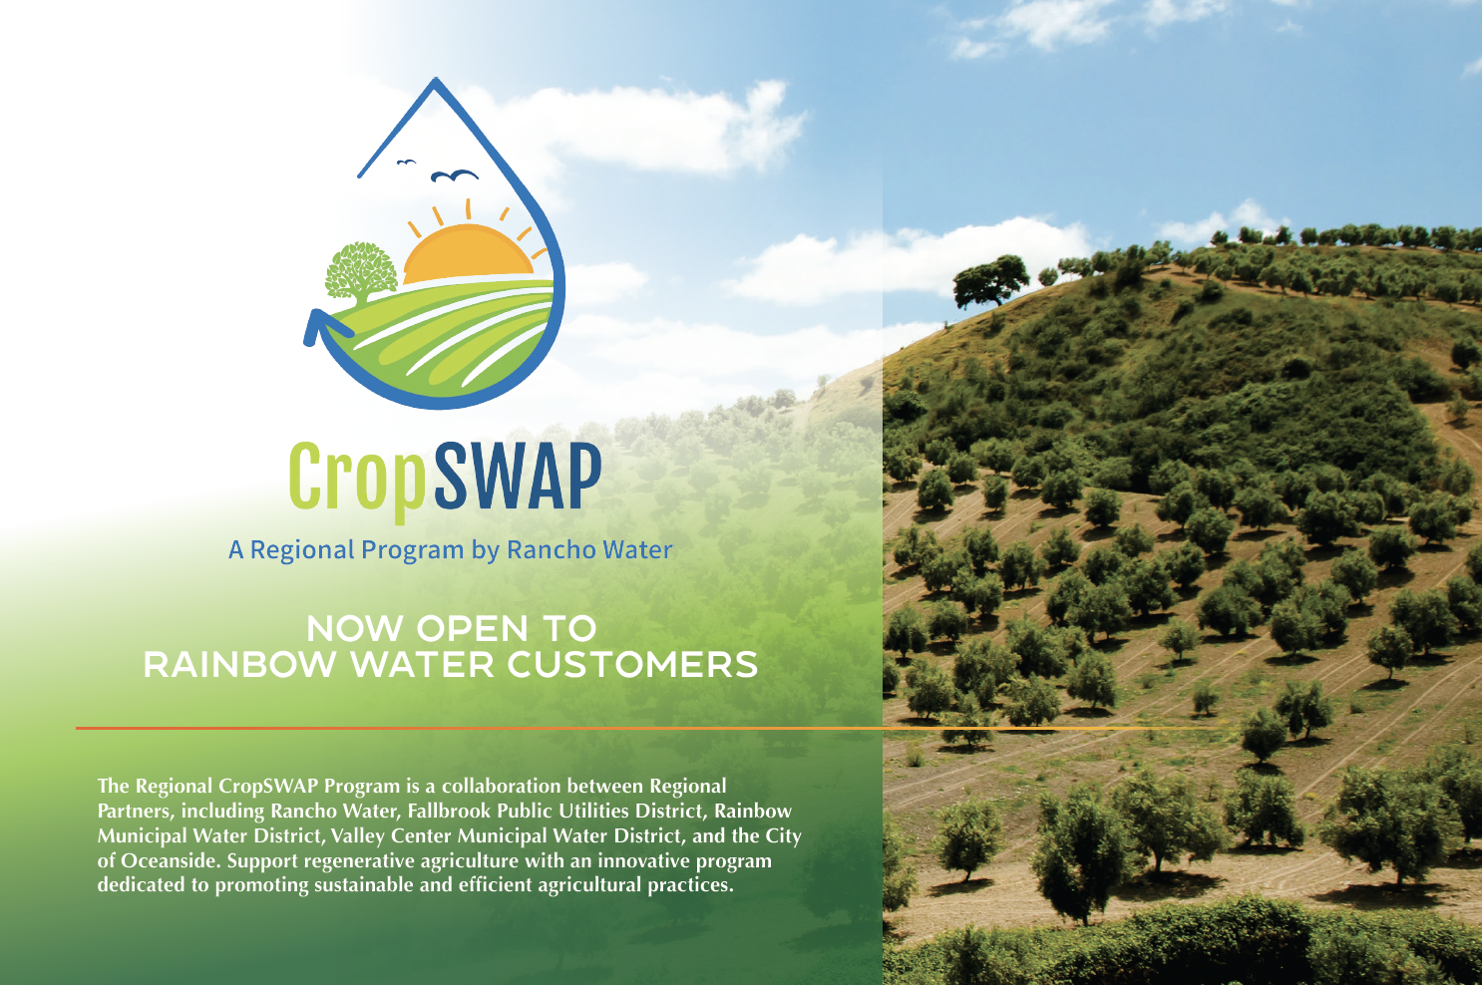
Crop SWAP Program
Program Launch
April 29 online application portal opened to regional customers
Regional Program promotion in place and push BMP’s
Website updated with program framework and link to website
Notes:
Regional CropSWAP Program launched on April 29 and a total of 8 applications have been submitted by Rainbow Water customers.
Push best management practice information out with Rancho Water
Rainbow Water is leading in largest participation among the Regional Partners.
A campaign to inform customers included: direct mail postcard to all agriculture customers over 1 acre; email to customers on interest list; letter mailed to interest list; press release in Village News; website page; and May newsletter article.
Currently projects are under review pending inspection and approval with Rancho Water’s project administrators.
Rainbow Water is set to exceed the allotted $200k budget and begin to use the shared funding pool.
The top applications by project type: avocado rootstock, crop rejuvenation, and crop conversion.

Slide 12
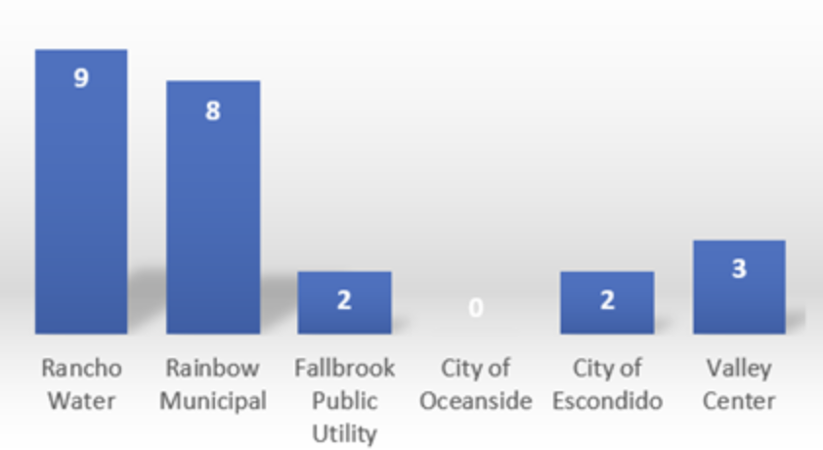
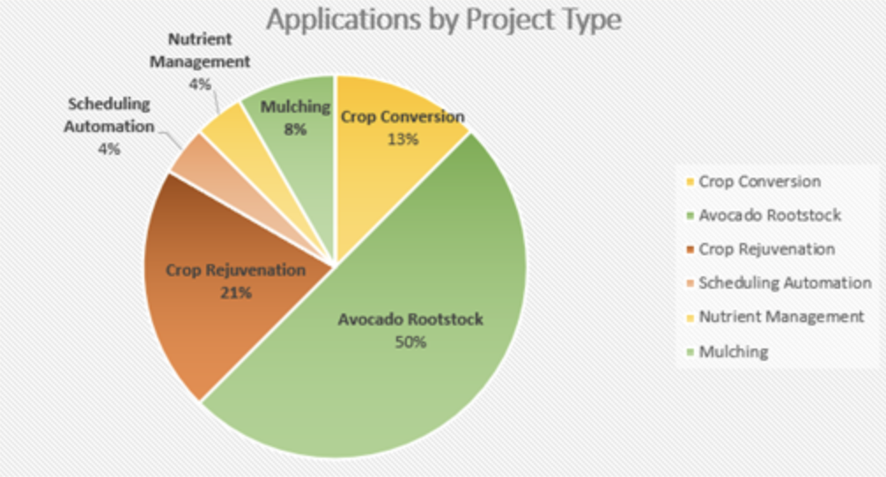
Application Metrics
Rainbow Water customers have sent in eight applications within the first two weeks
Top program is avocado rootstock
Rainbow Water is leading in program participation
Set to exceed $200k budget and will begin to use shared fund
Notes:
Rainbow is by far leading the pack in terms of number of applicants. As of last week, Rainbow had a total of 8 applications submitted. Currently no project has been approved as they are going through the inspection process, but projects should start seeing approval within the week. Right now, if the current number of applicants are approved, Rainbow will exceed their allotted $200k budget and start to dip into the shared funding pool.

Slide 13
Customer Service Survey
2024 Recap

Slide 14
Survey Review
2024 Questions:
Please rate the quality of water delivered by Rainbow Water? (Based on taste, color, and smell)
How would you rate the courtesy and professionalism of Rainbow Water employees?
How satisfied were you with the level of knowledge of the Rainbow Water employee who assisted you?
Do you feel Rainbow Water cares about your concerns?
Rate the speed of service and responsiveness of doing business with Rainbow Water.
How do you prefer to receive communication from Rainbow Water? (Please check all that apply)
Billing insert, direct mail, newsletter, newspaper, phone call, social media, text message, website
Survey Goals
Review water and customer service experience
Identify preferences for communication
Establish a consistent metric, rate on a scale from 1 – 5.

Slide 15
2024 Survey Results
What we learned from the survey
Customers prefer to receive messages via billing insert, text or direct mail
85% respondents rated 5 out of 5 for customer service, knowledge, response and resolution.
100% of respondents rated 5 out of 5 for Rainbow Water caring about customers concerns.
Speed of service 4.7 rating
100% completion rate for survey
14 Responses from Avocado Festival
Survey Status
Available at Avocado Festival
Currently: Newsletter, website
Customer Service Professionalism and Knowledge Rating 4.9%
Preferred Method of Communication: Billing insert, text message and direct mail

Slide 16
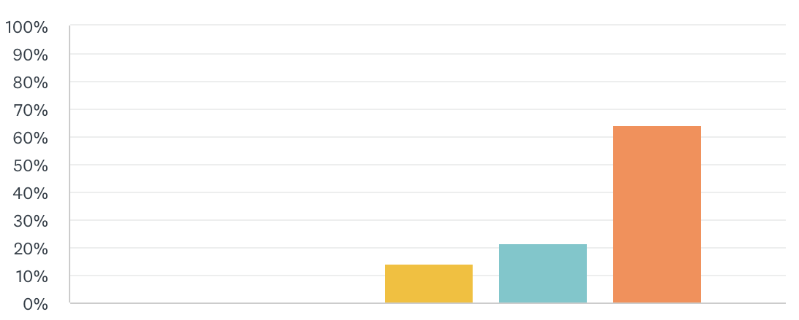
Water Quality Rating
Water quality based upon taste and color results ranged from 3 to 5
Survey Scale 1 to 5
5: Highly Satisfied
4: Satisfied
3: Neither Satisfied nor Dissatisfied
2: Dissatisfied
1: Highly Dissatisfied

Slide 17
Newsletter Content Planning

Slide 18
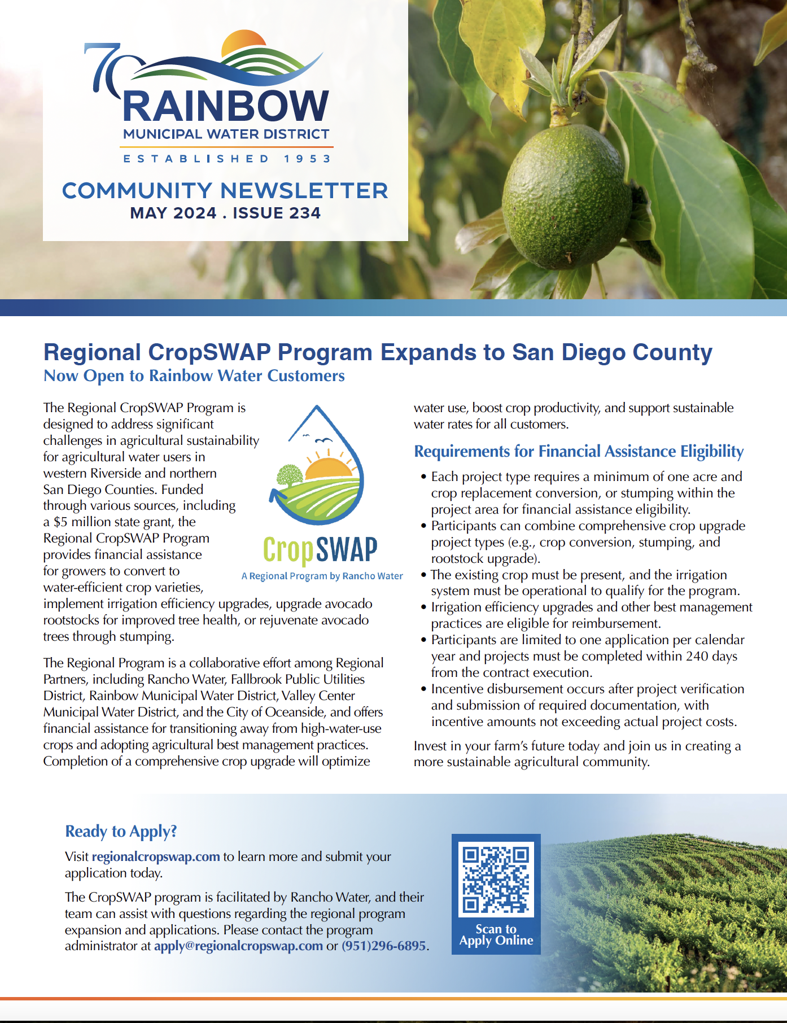
Newsletter Review
May
Regional CropSWAP Program Expands to San Diego and Riverside Counties
Bonsall High School Students Tour Rainbow Water Headquarters
Garden Like a Pro
Five Tips to Save Water and Grow a Sustainable Garden
50 Native Plants brochure available at the Rainbow Water office
New Survey
New Customer Service Survey link

Slide 19
Newsletter Planning
June
Rates & Detachment Update
Rate increase details
Infographic of CA water project & Colorado River, Met to RMWD
CCR Report link
Part 2 of Tips to Grow a Sustainable Garden
Rebates from Met: Turf, Trees, Adjust Sprinklers for Summer
Outreach Update
Calendar Contest Winners
Rainbow Run on June 15
July
Value of Water
Explain how price of water pays for components of infrastructure, maintenance, and more to deliver safe reliable water
Summer Water Guide
Tips for adjusting water for heat
Share Your Experience
Take the customer service survey
Backflow Device Review
Flume
Rebates available for Prime Day

Slide 20
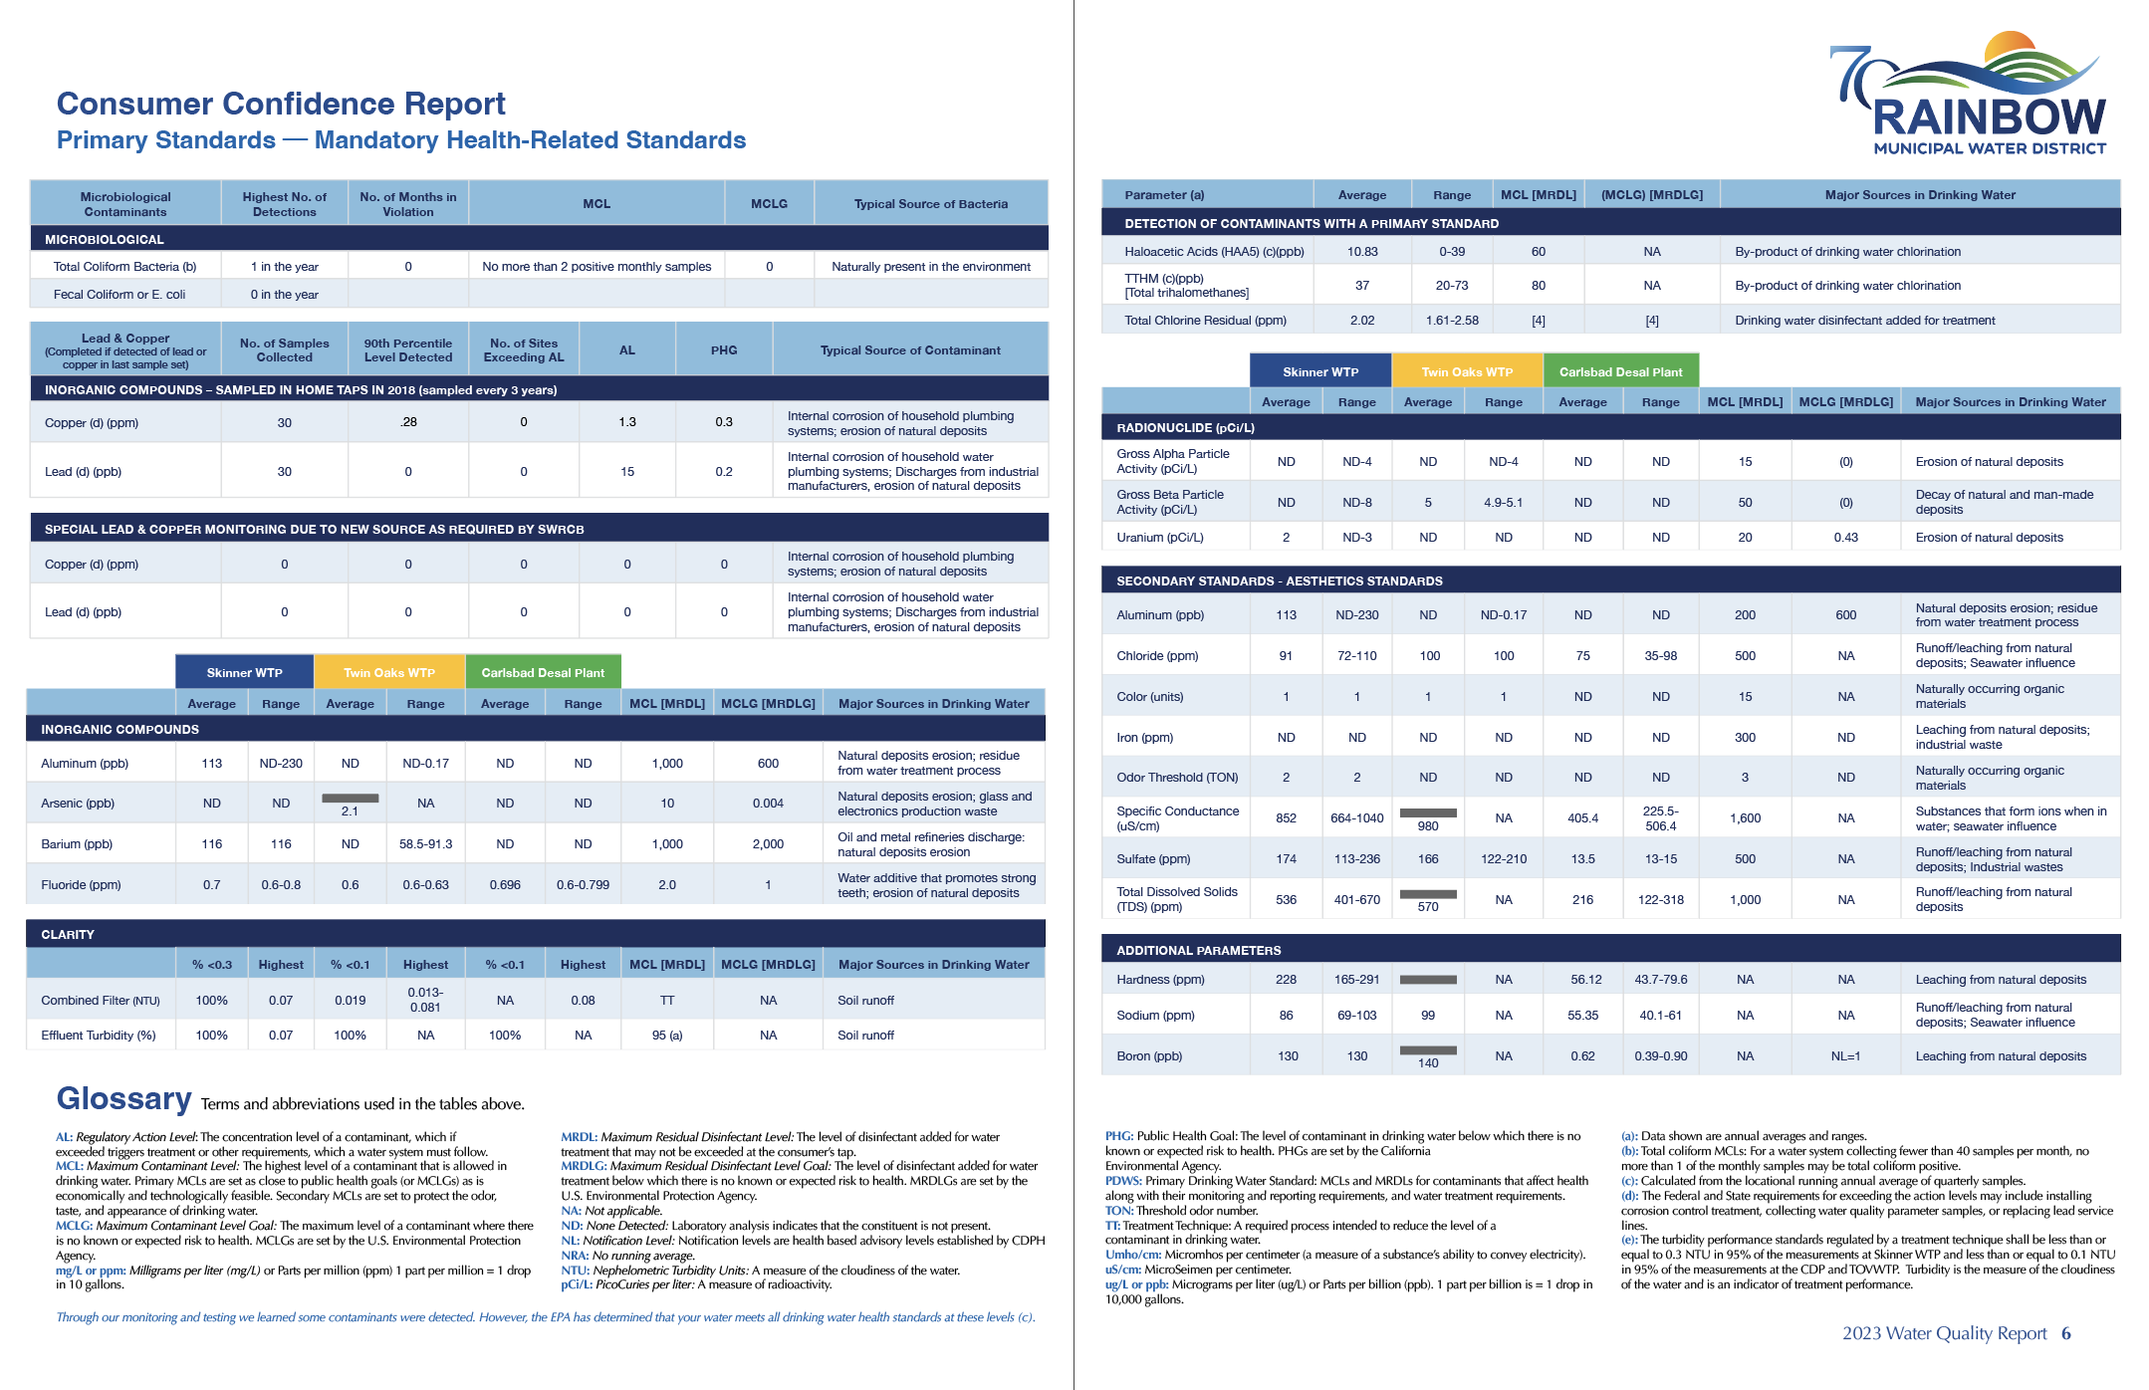
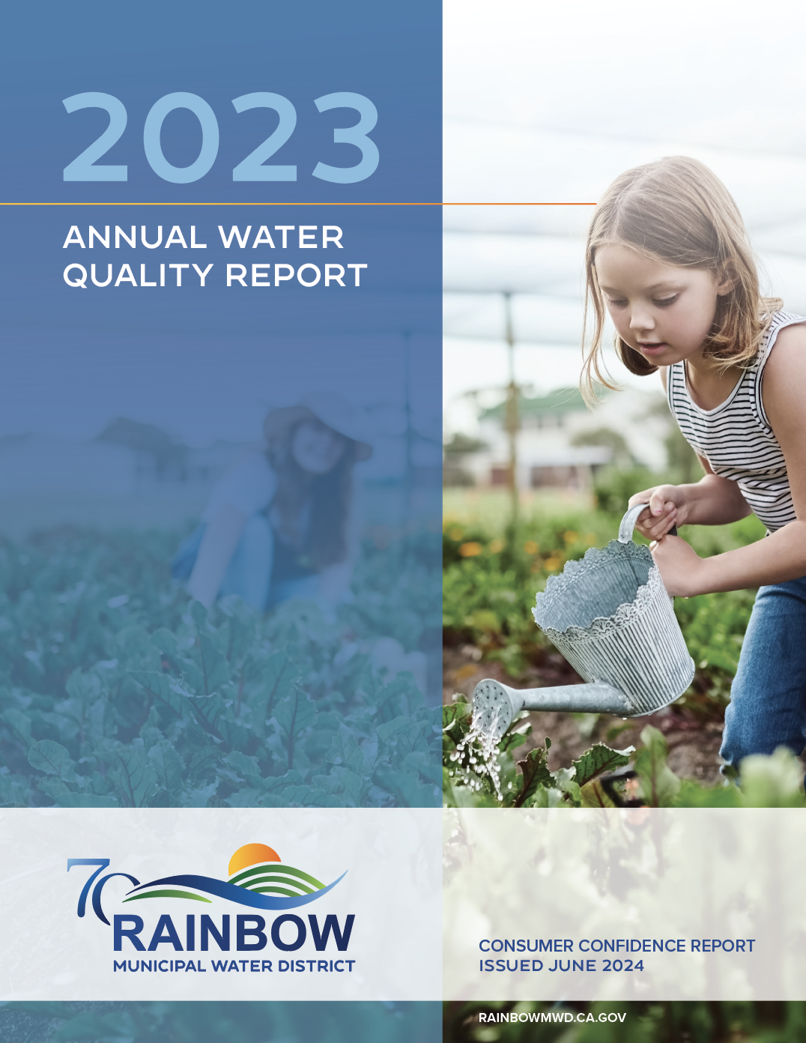
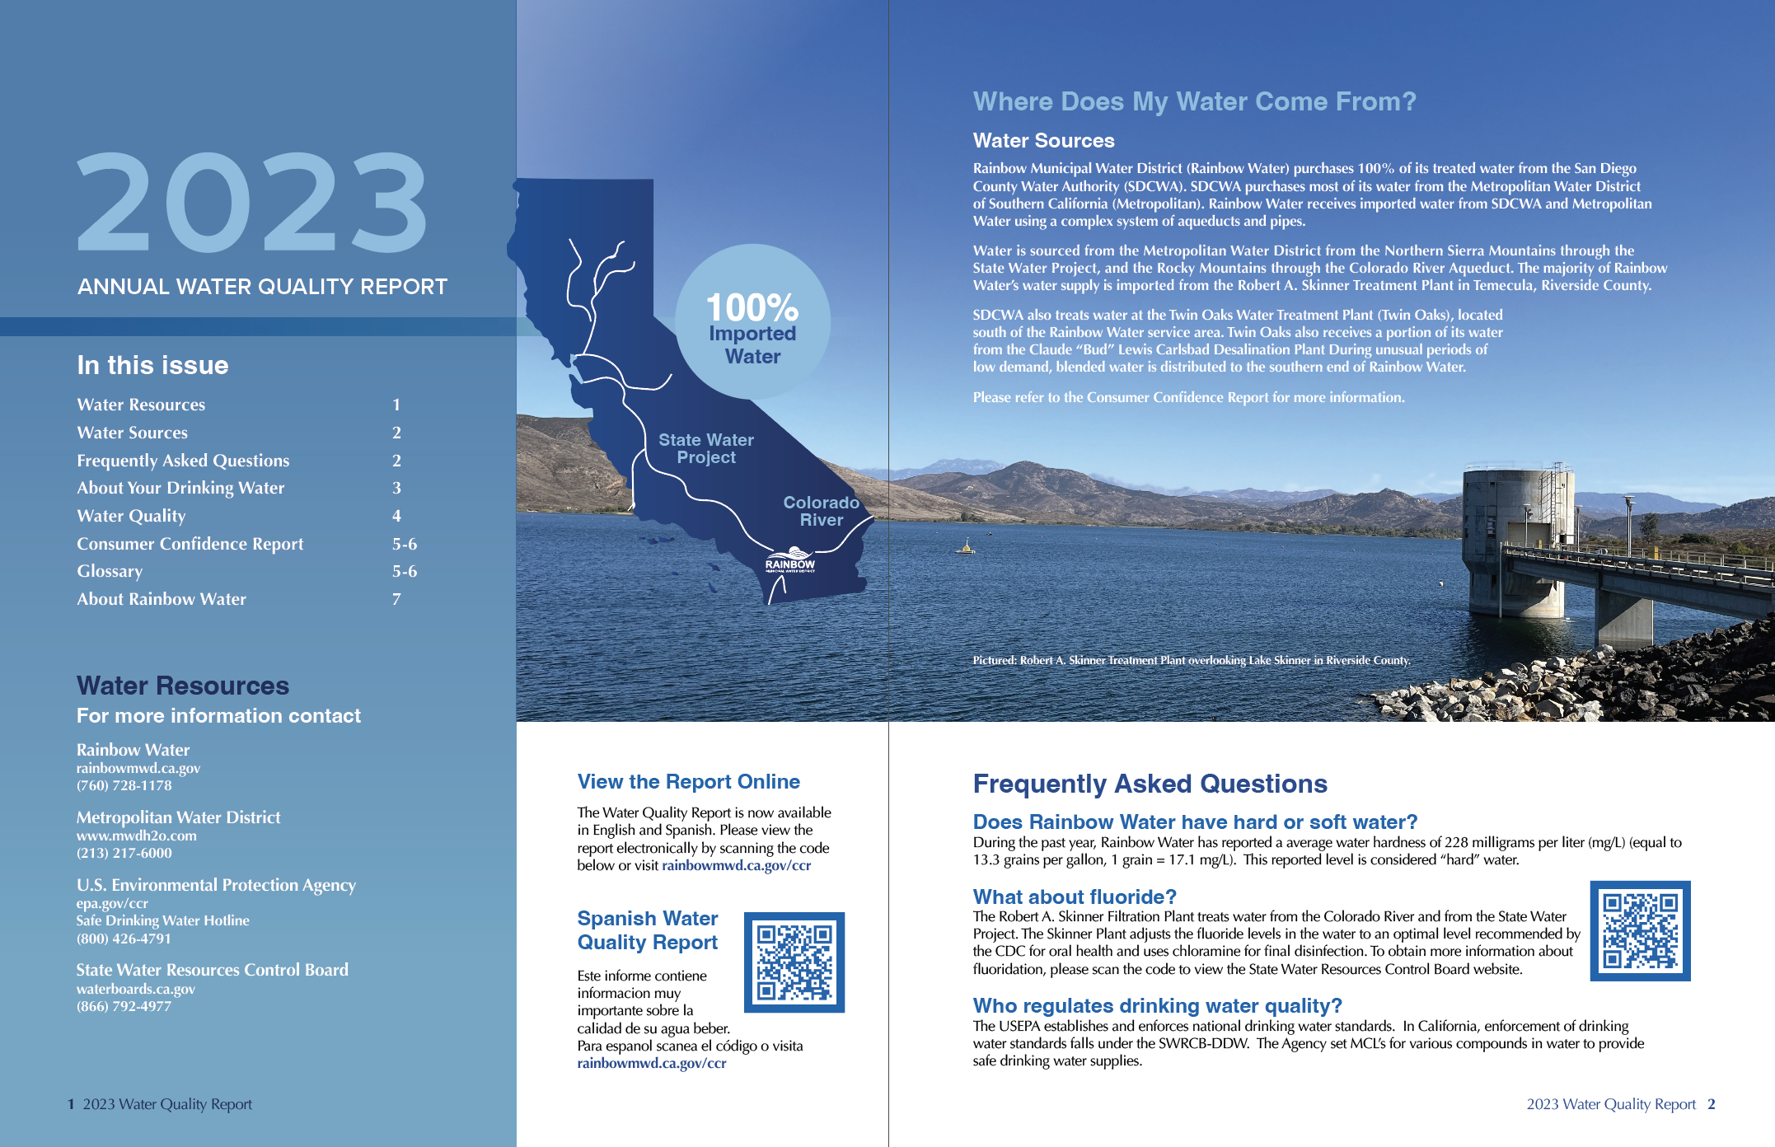
Newsletter Feature
CCR Report
Link to online brochure in English and Spanish

Slide 21
Community Events Update

Slide 22
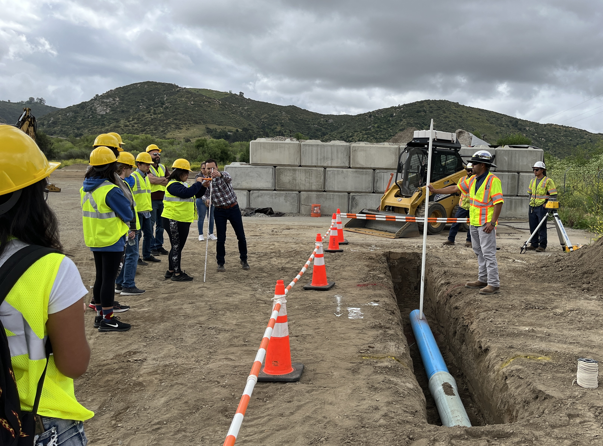
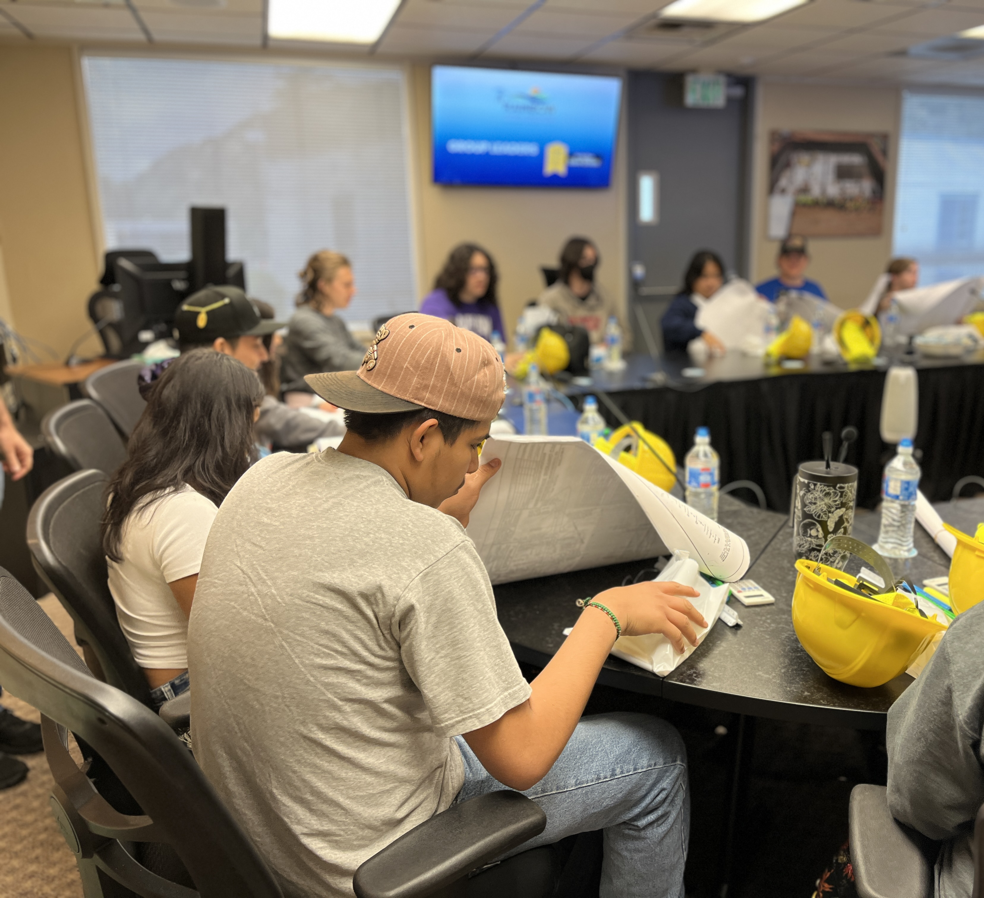
Field Trip
Hosted Bonsall High School field trip on April 25
Students toured headquarters for an inside look at the day-to-day operations of a water agency
Grant funds were used to purchase hard hats, safety vests and glasses, rulers, calculators, and STEM kit

Slide 23
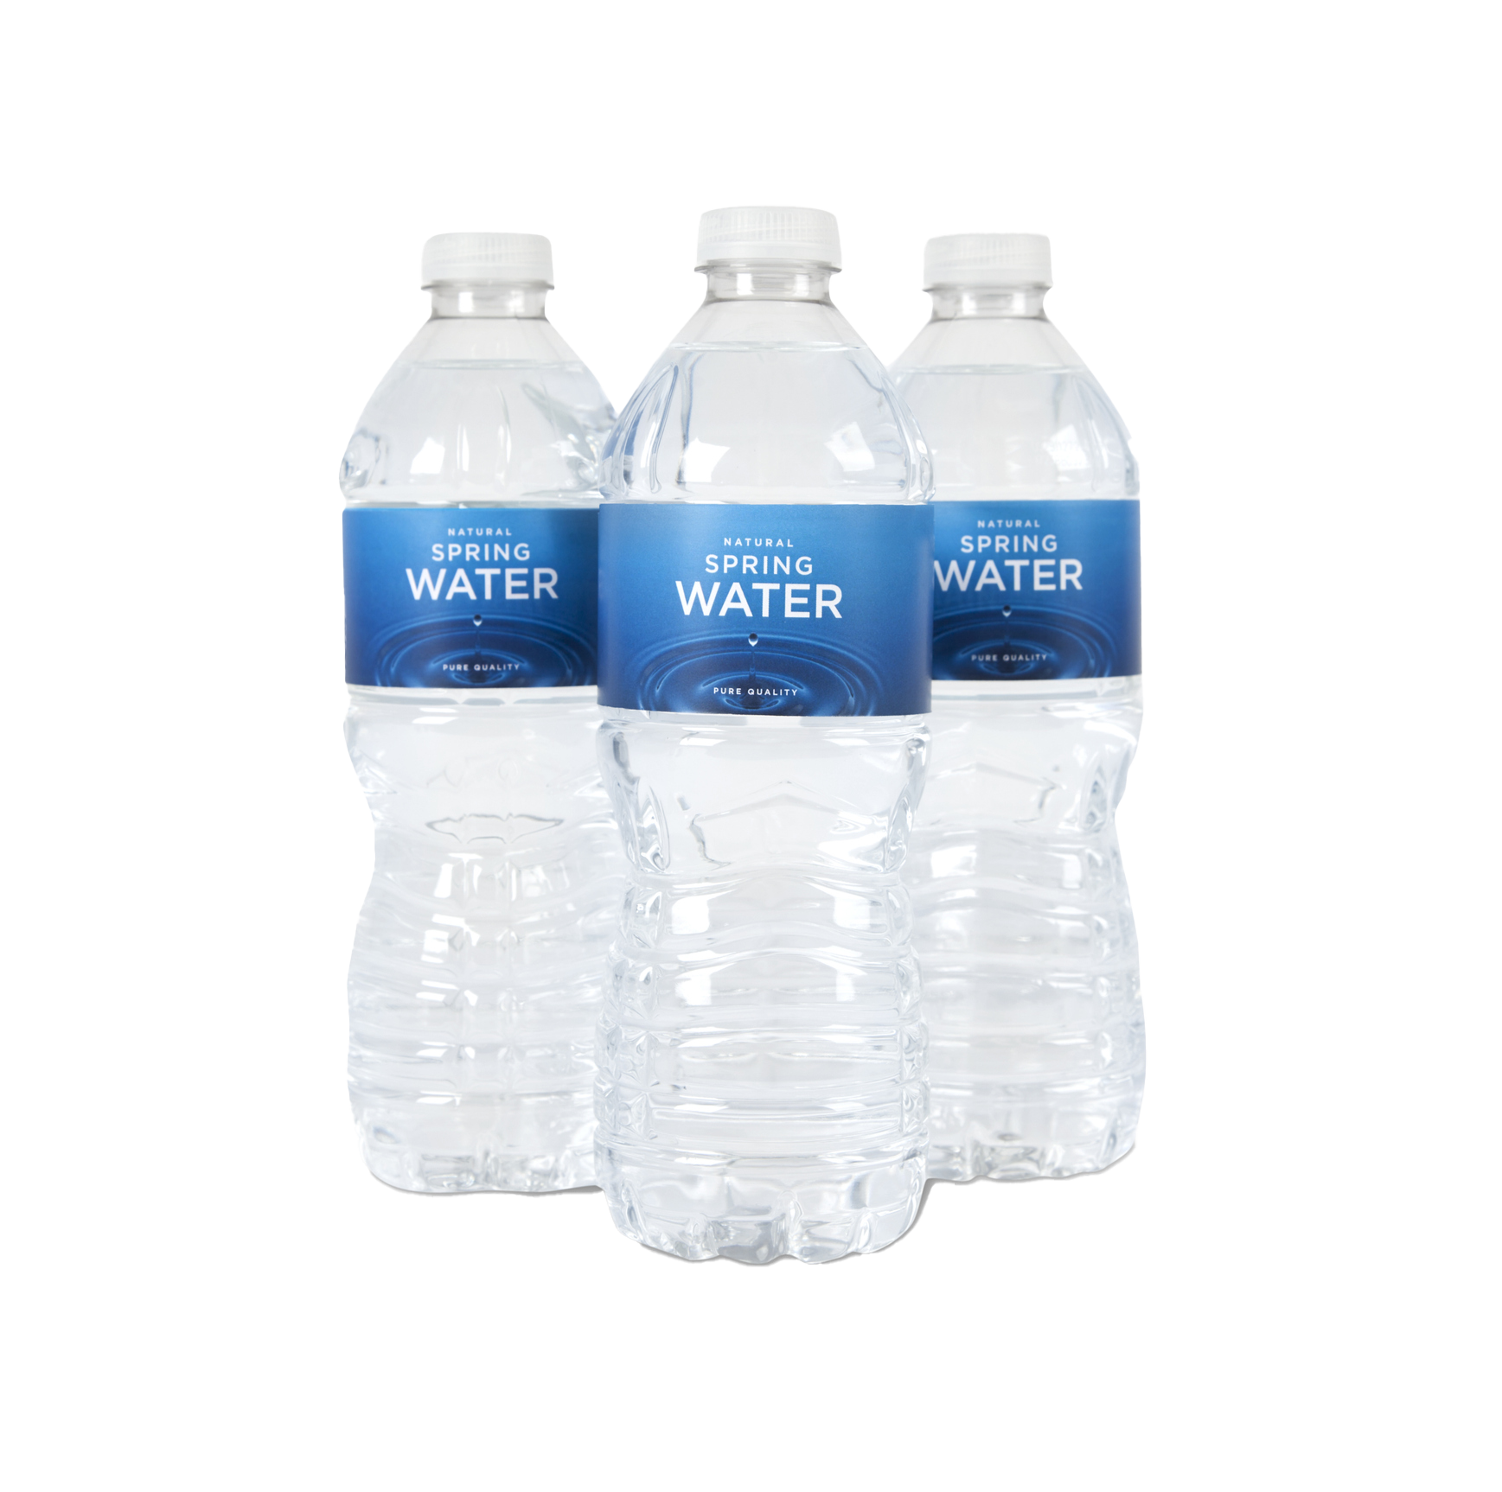
Rainbow Run
Saturday, June 15
Starts 7:00 a.m.
3K Race for Runners and Walkers at Vallecitos Elementary Parking Lot
Registration $30 thru May 29
Rainbow Water is the water station sponsor
Notes:
At Vallecitos Elementary we are on a mission to encourage healthier habits in our students, families, and communities! During this fun event we hope to mix fun and movement with Rainbow and Fallbrook community vendors.
https://raceroster.com/events/2024/86799/first-annual-rainbow-run
Promo Code: WATER24

Slide 24
Thoroughbred Liftstation
Ribbon Cutting Event
Planning underway
Project will be complete end of September
Tentative date for Sept/Oct
Invite project partners, local businesses, chamber and Congressman Issa’s office

Slide 25
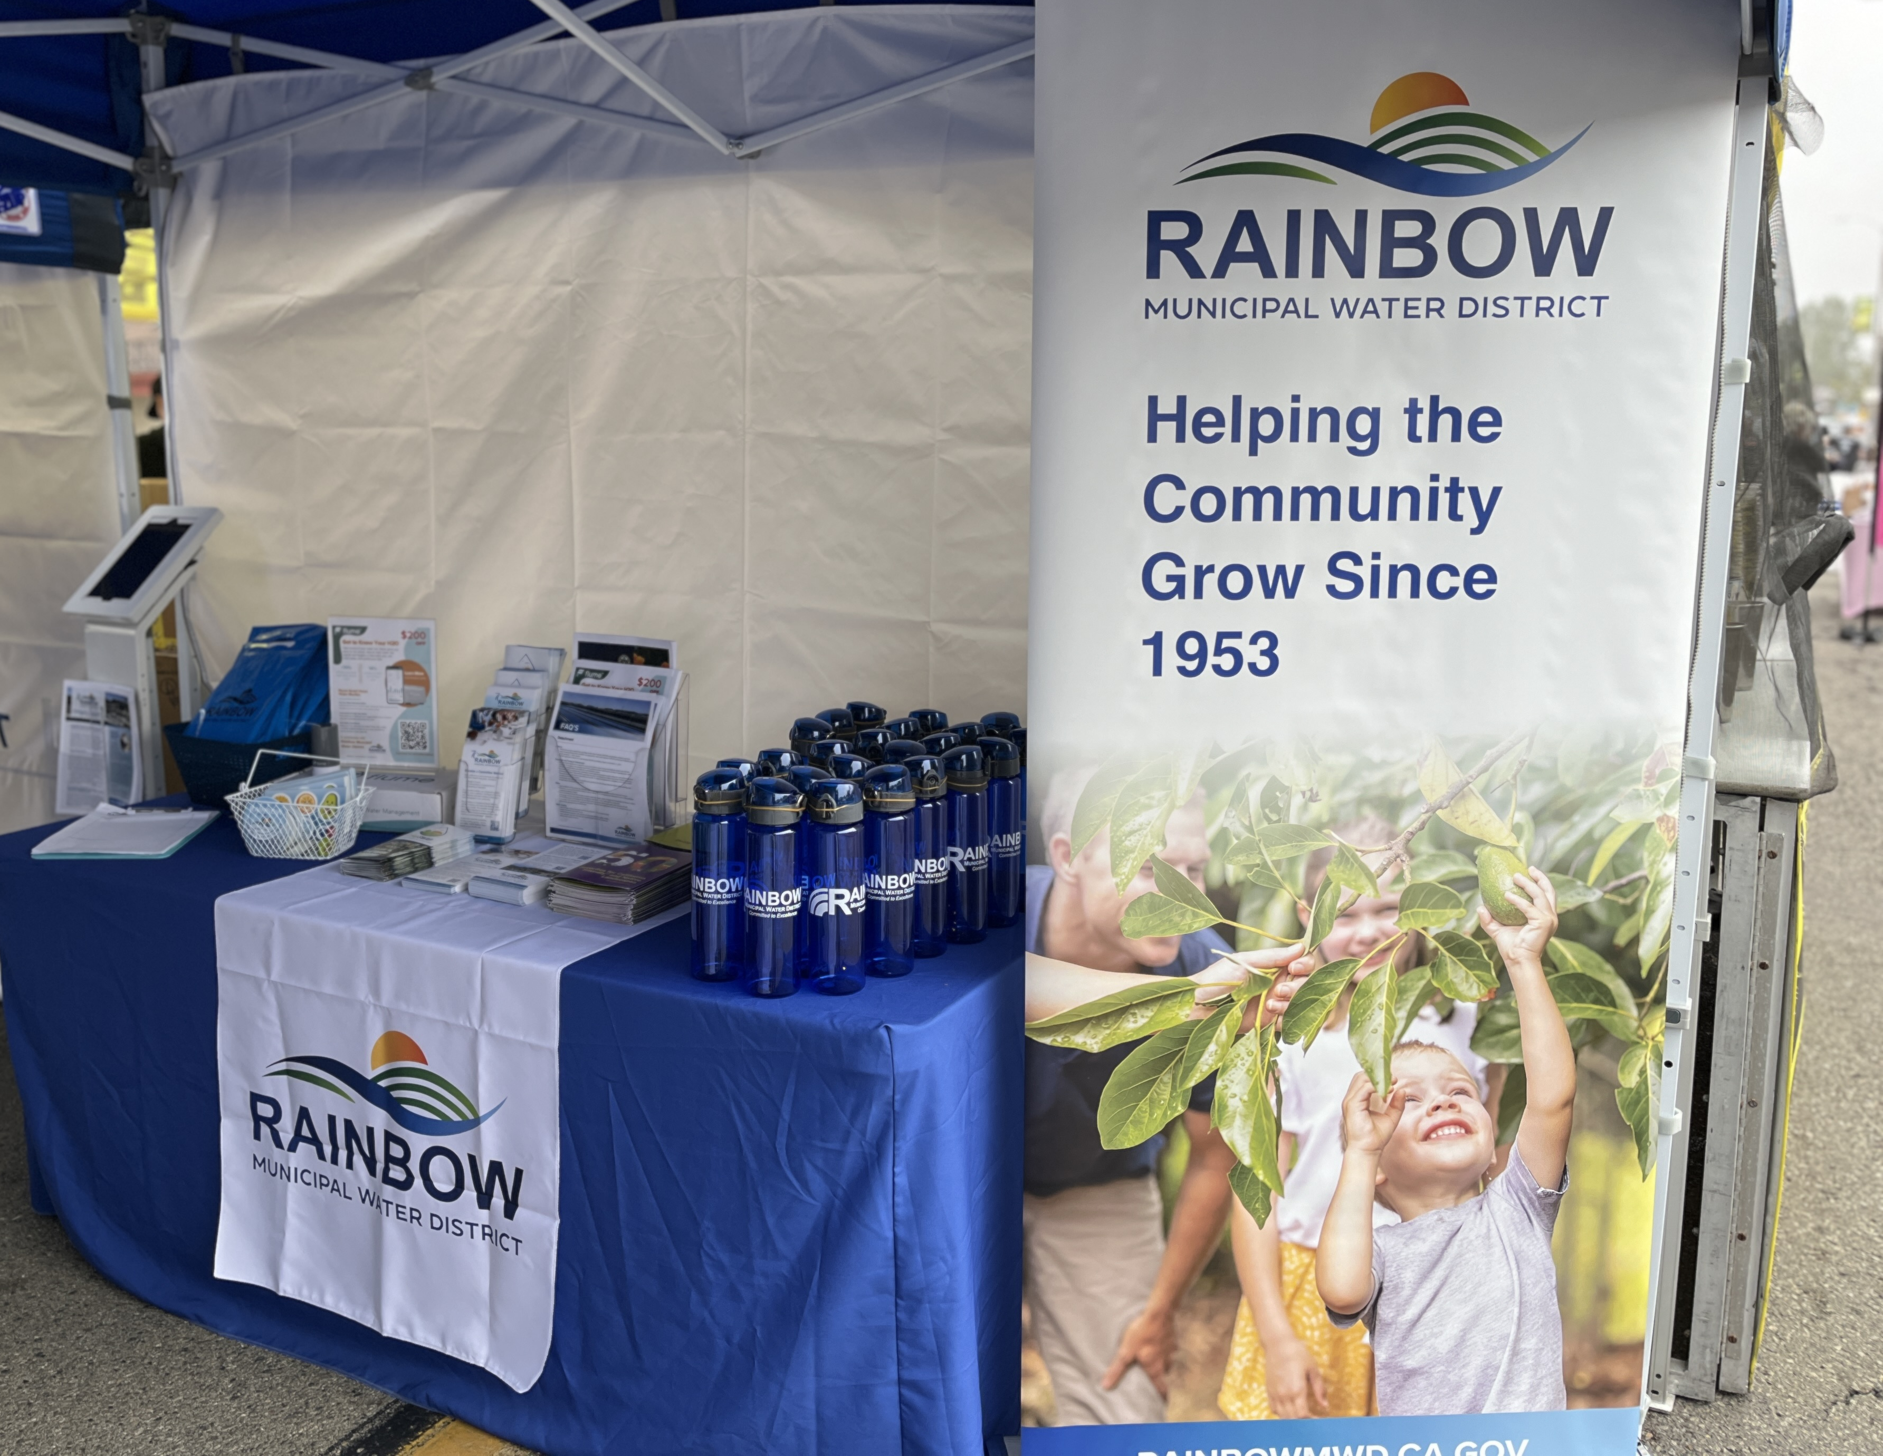
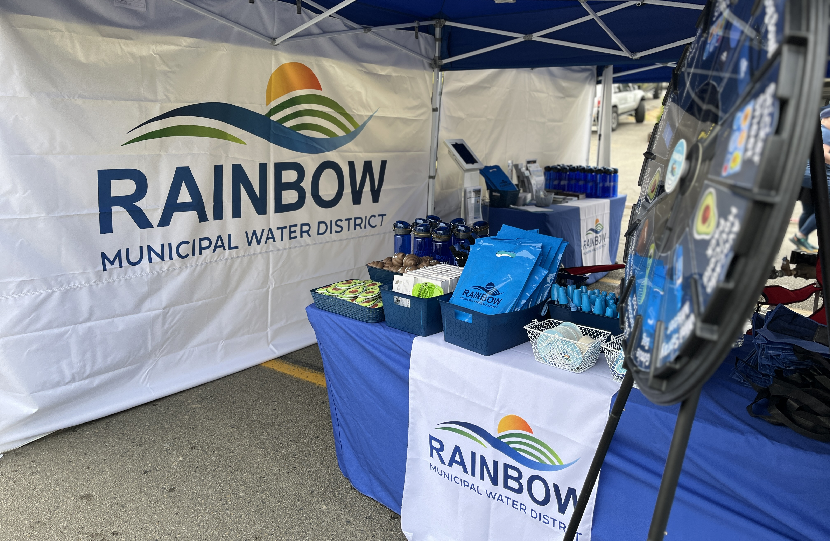
Avocado Festival
2024 Event Recap
The 37th Annual event attracted thousands of spectators
Total of 10 staff and 1 board member worked the Rainbow Water booth
Debuted new promotional swag with over 1,800 promotional items and 300 print collateral handed out to spectators.
Heavy flow of traffic from start to finish
Notes:
The team worked the Rainbow Water booth at the Avocado Festival in Fallbrook on Sunday, April 21st.
The booth received a constant flow of traffic from 9:00 a.m. to 5:00 p.m. with spectators winning promotional swag at the spin to win wheel.
Debuted new promotional swag displaying the new logo and handed out over 1,800 pieces of swag and 300 print collateral pieces.
675 items remaining, budget $5,600

Slide 26
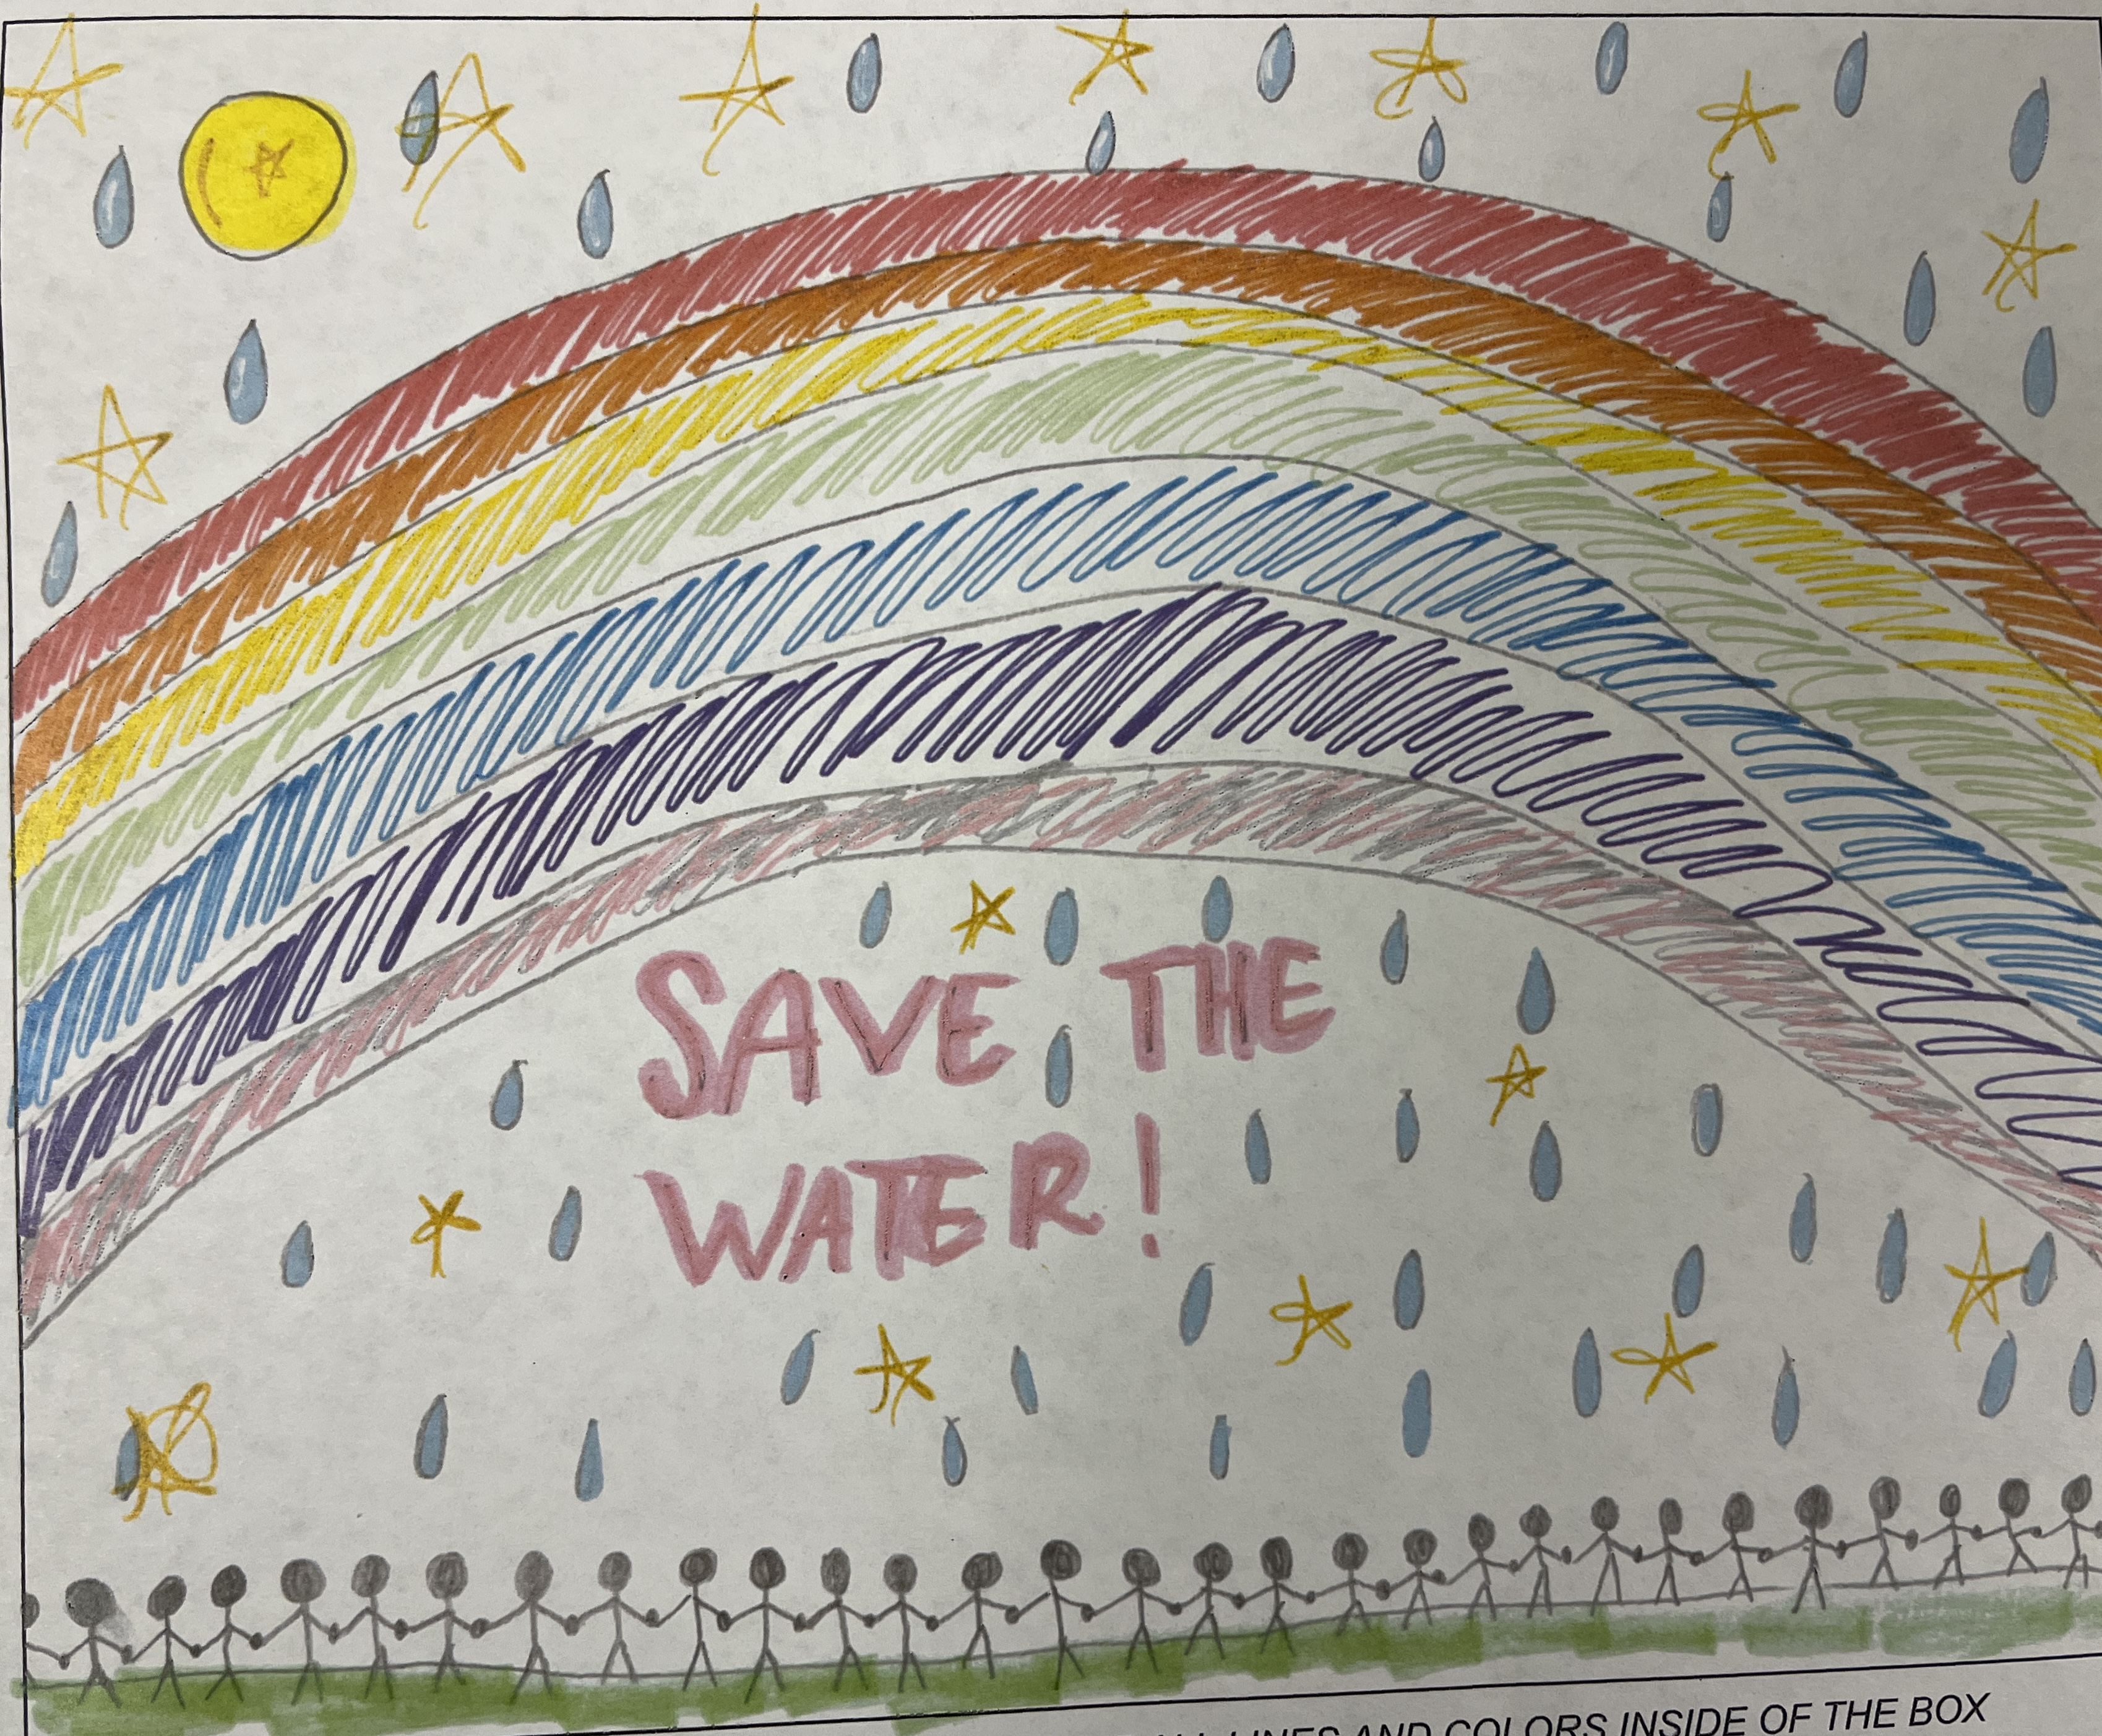
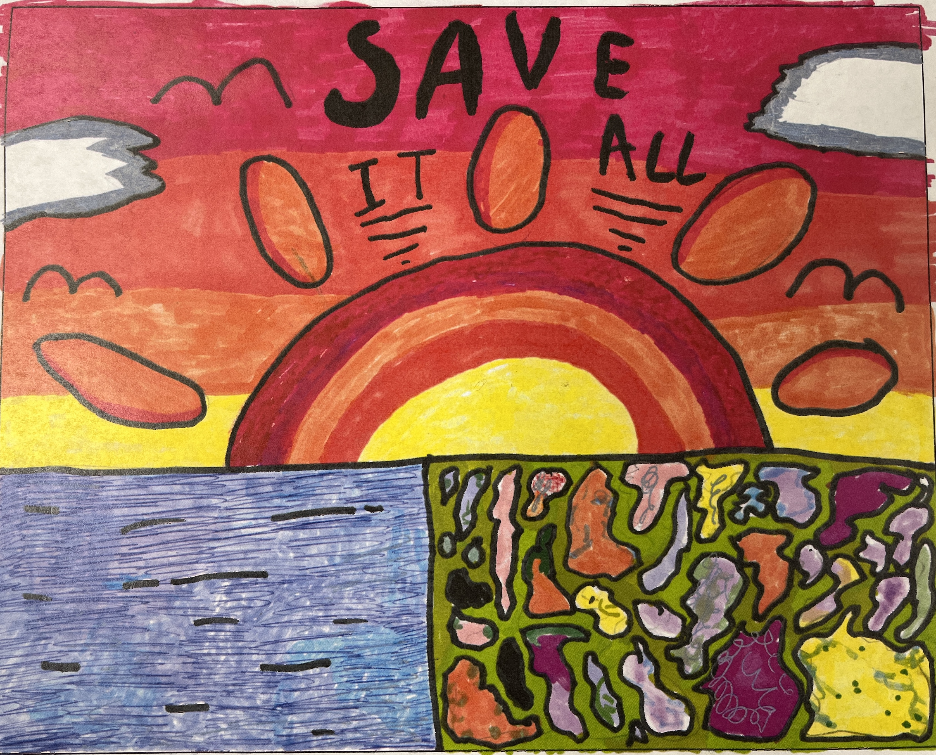
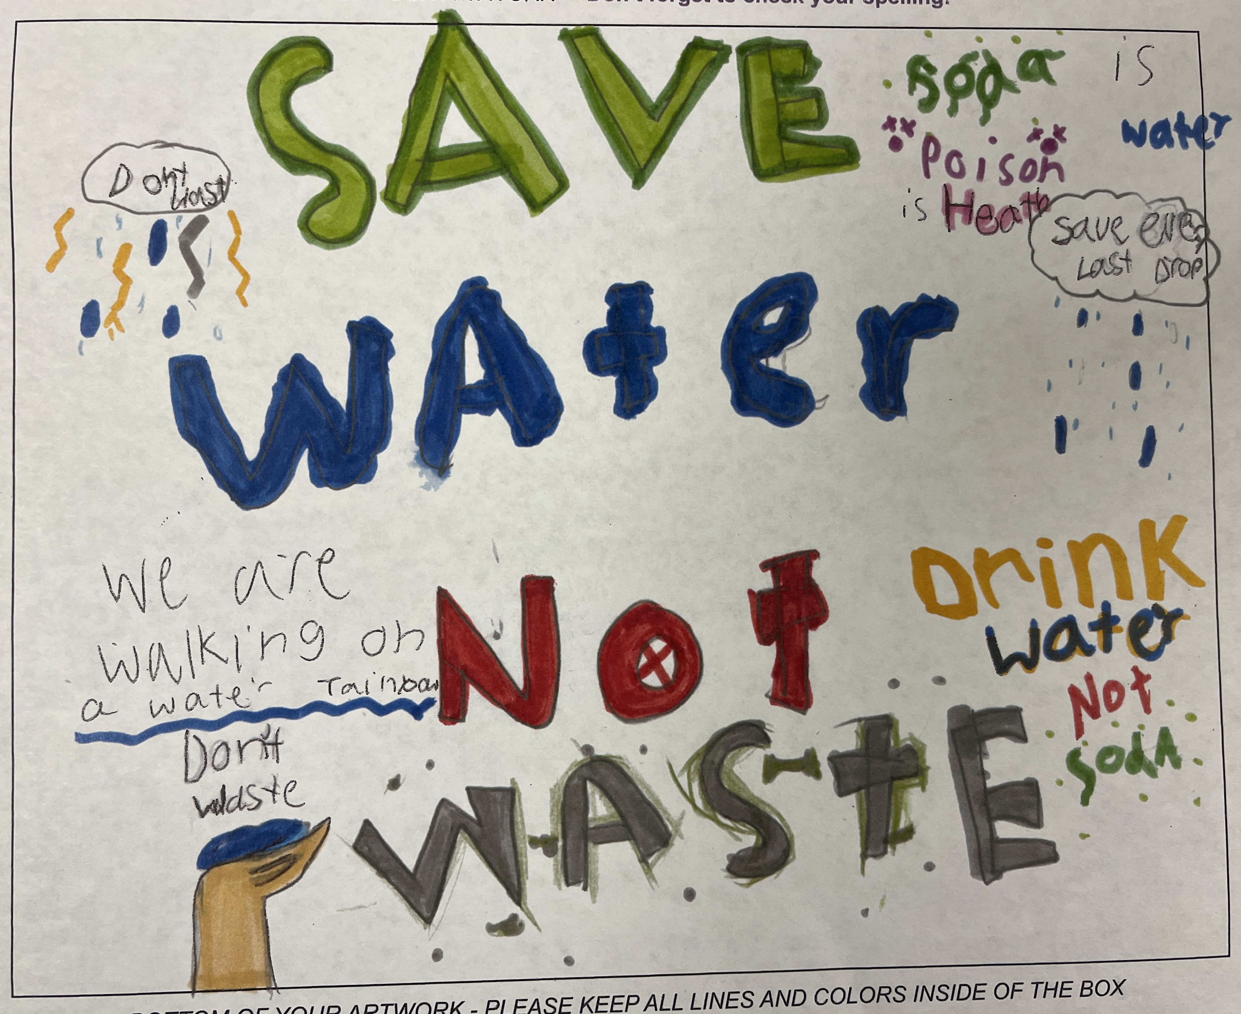
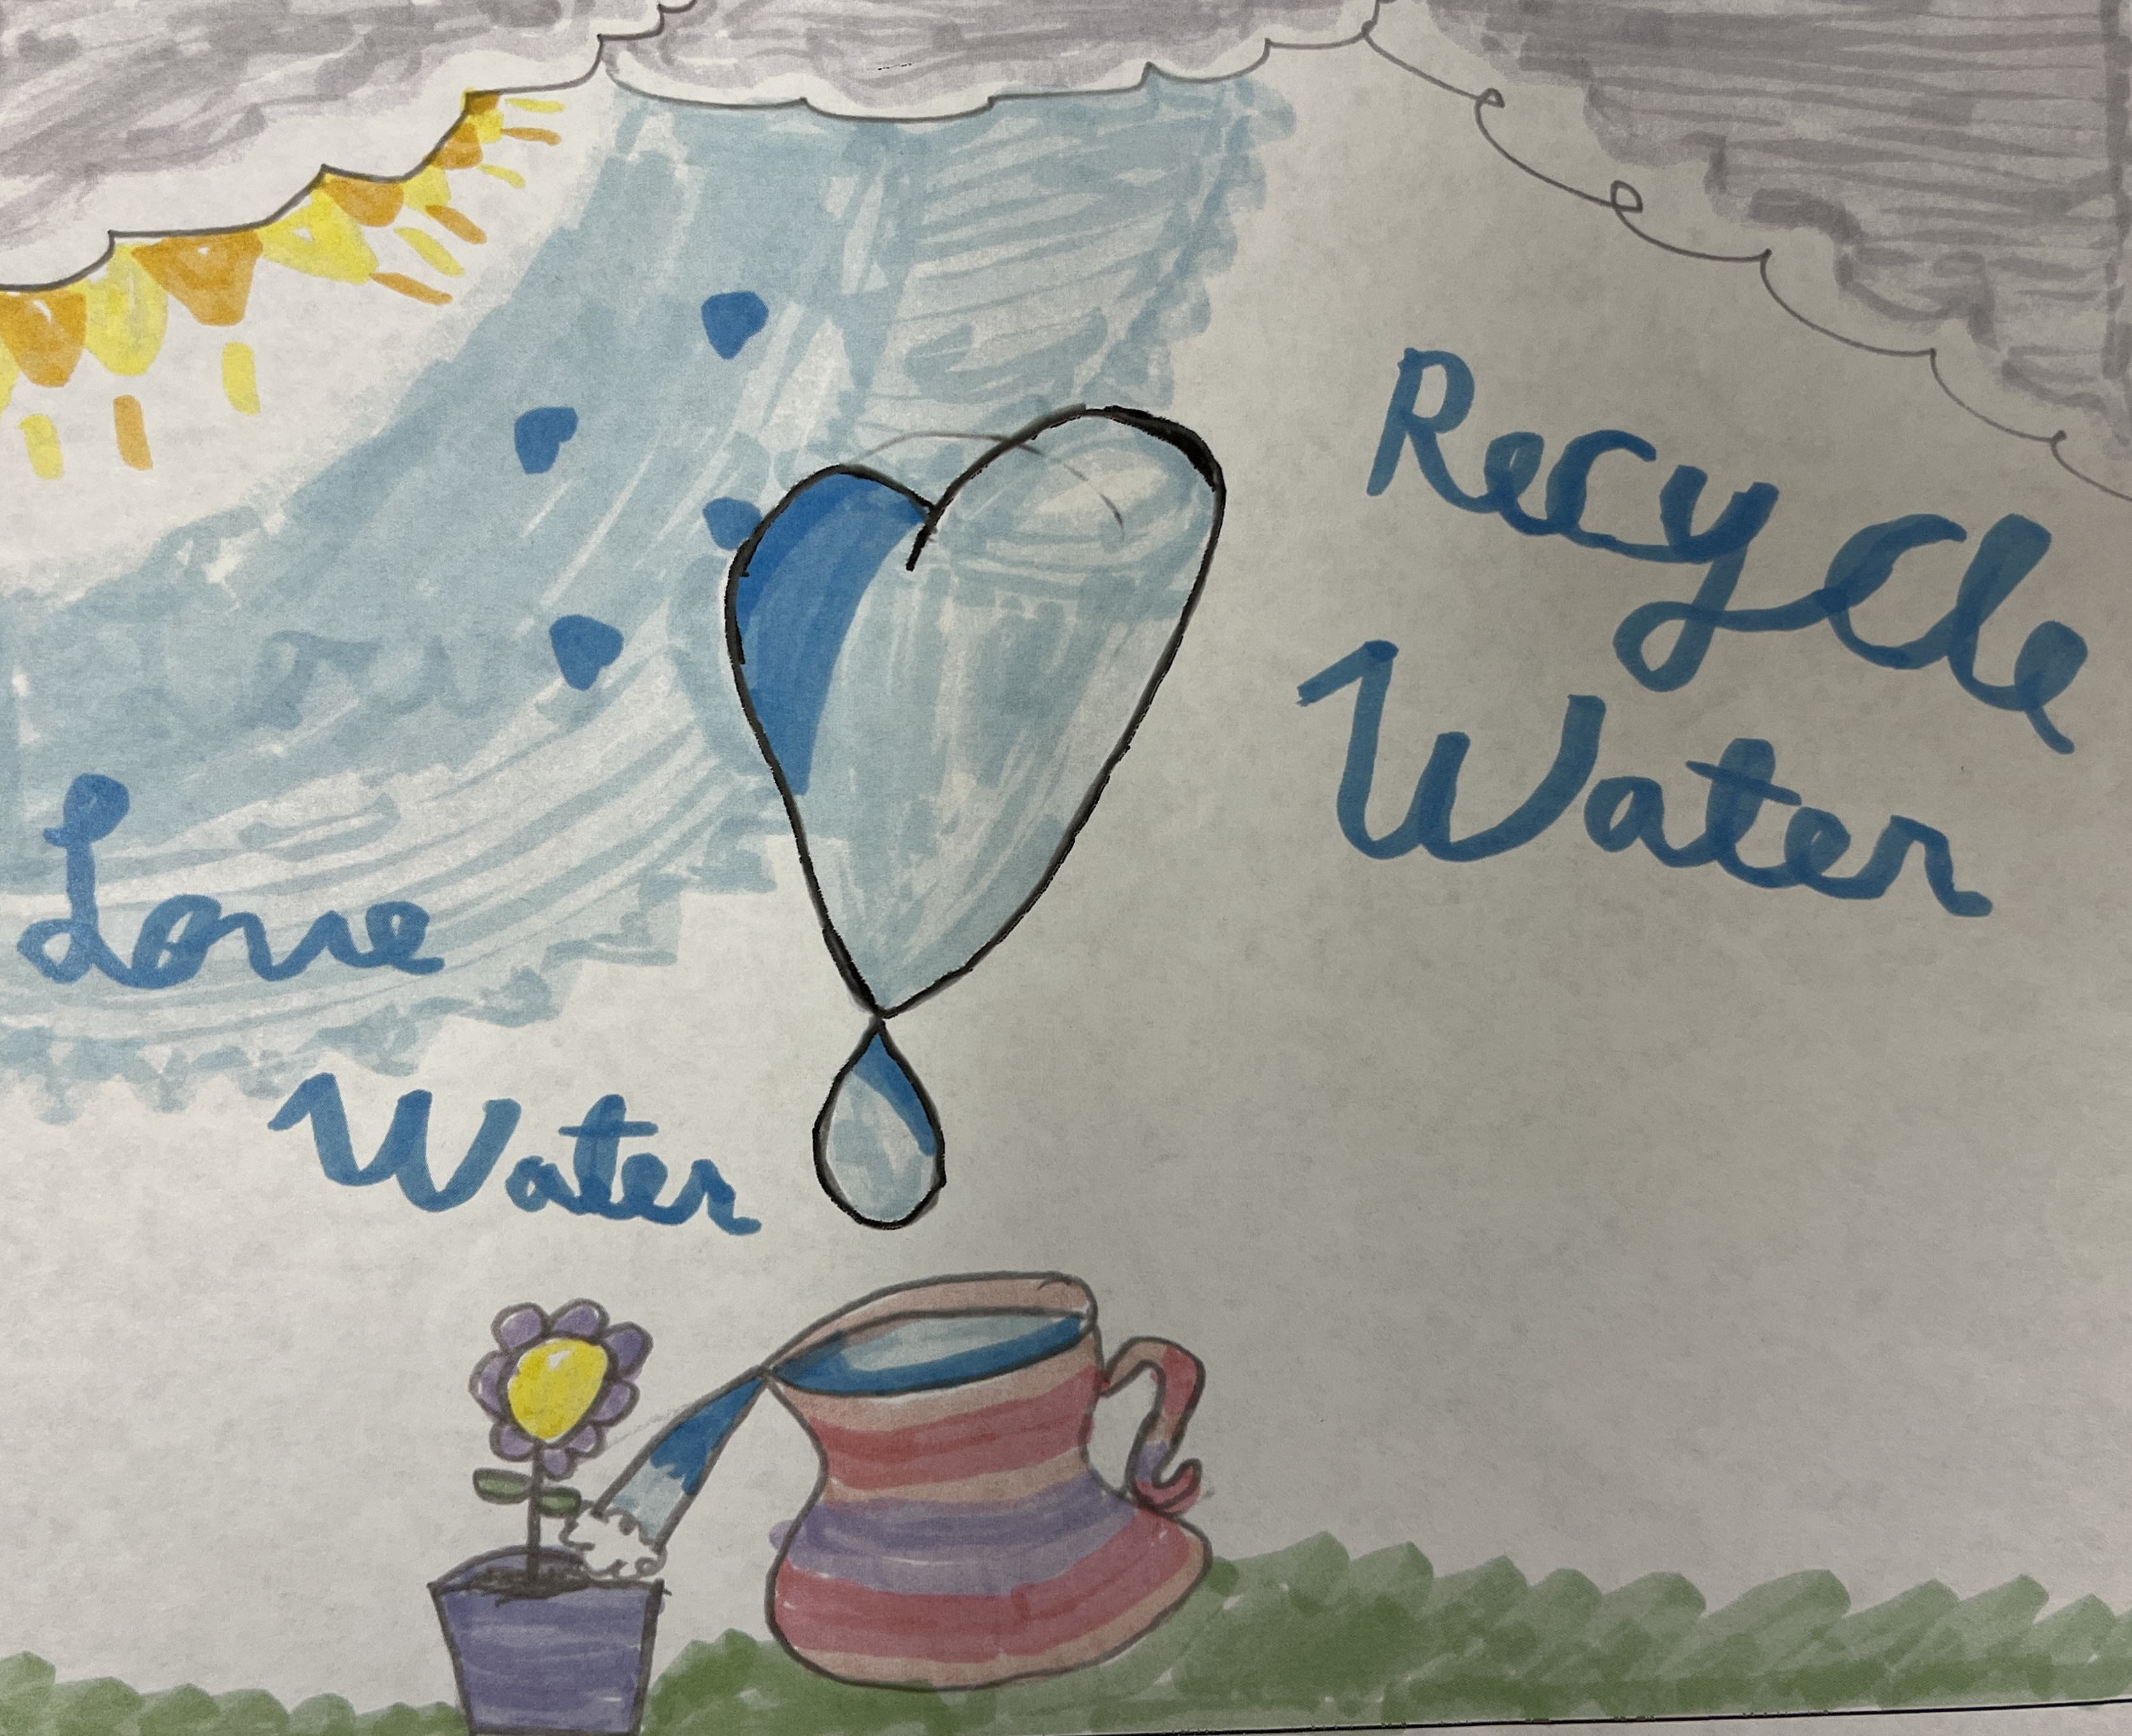
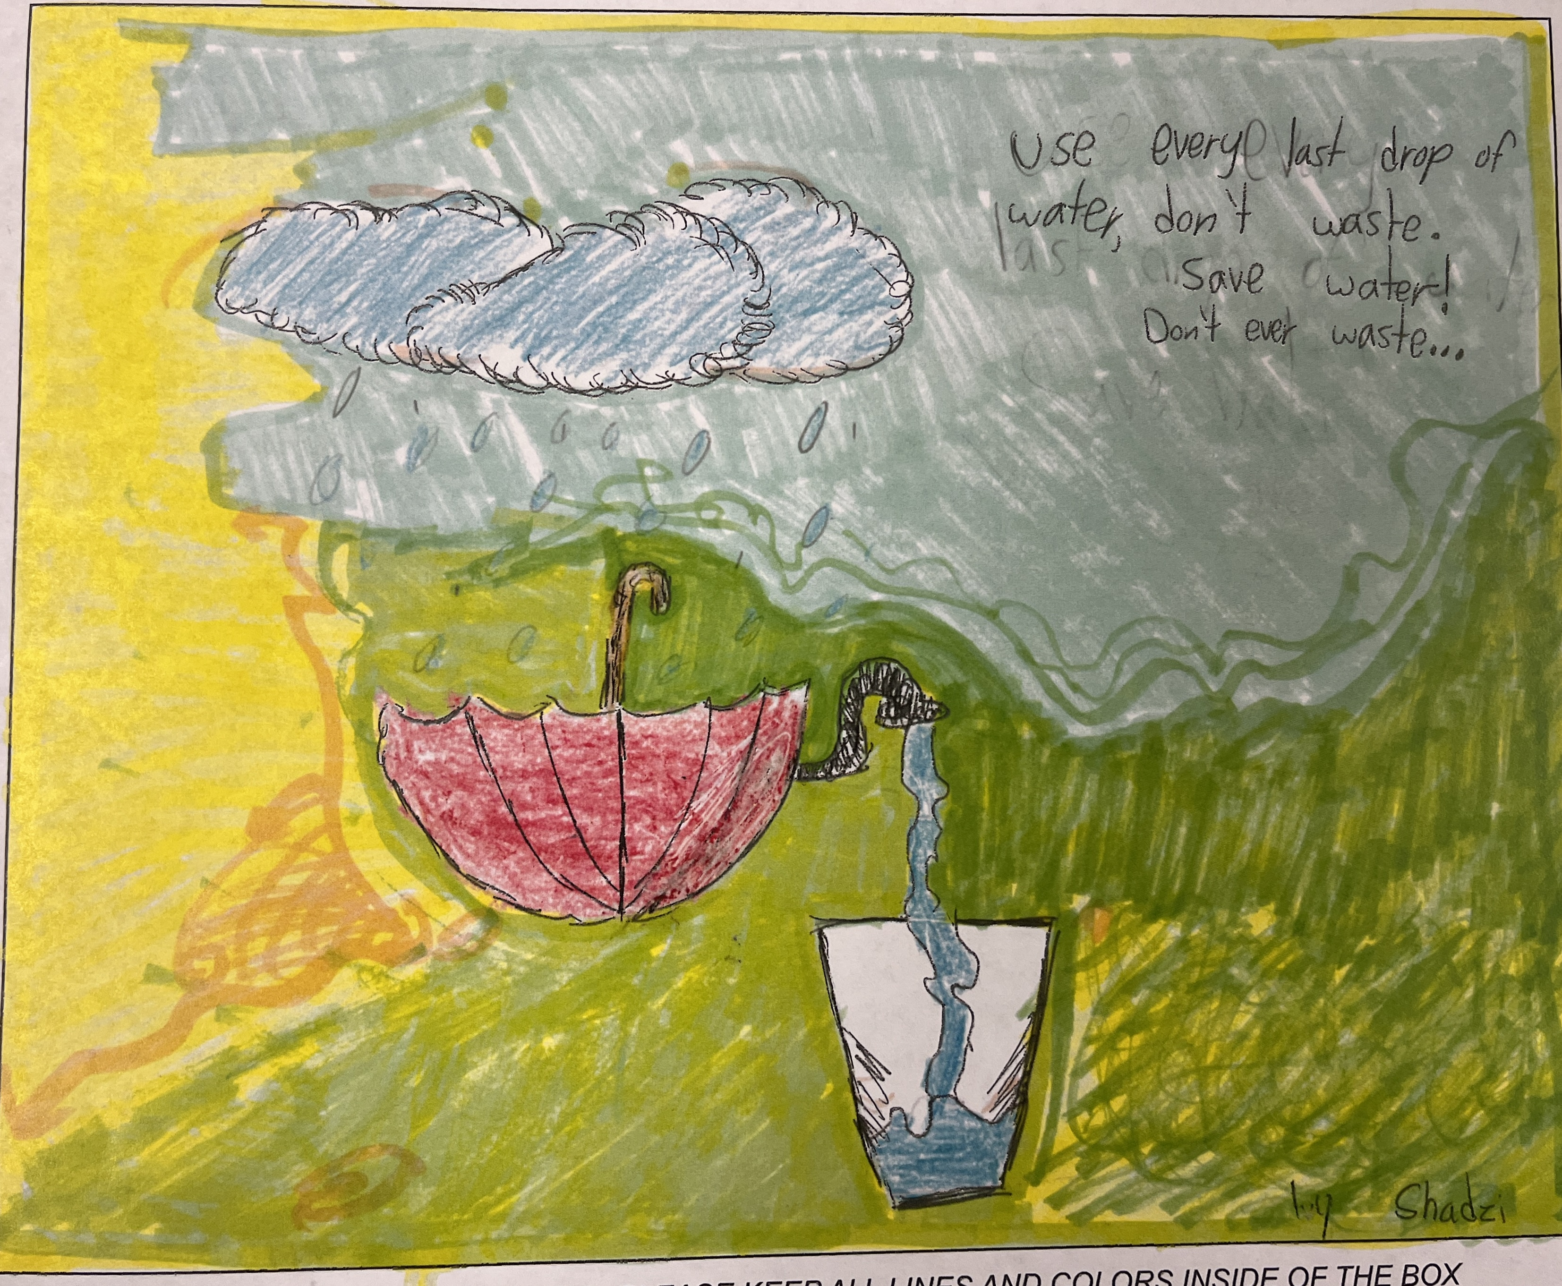
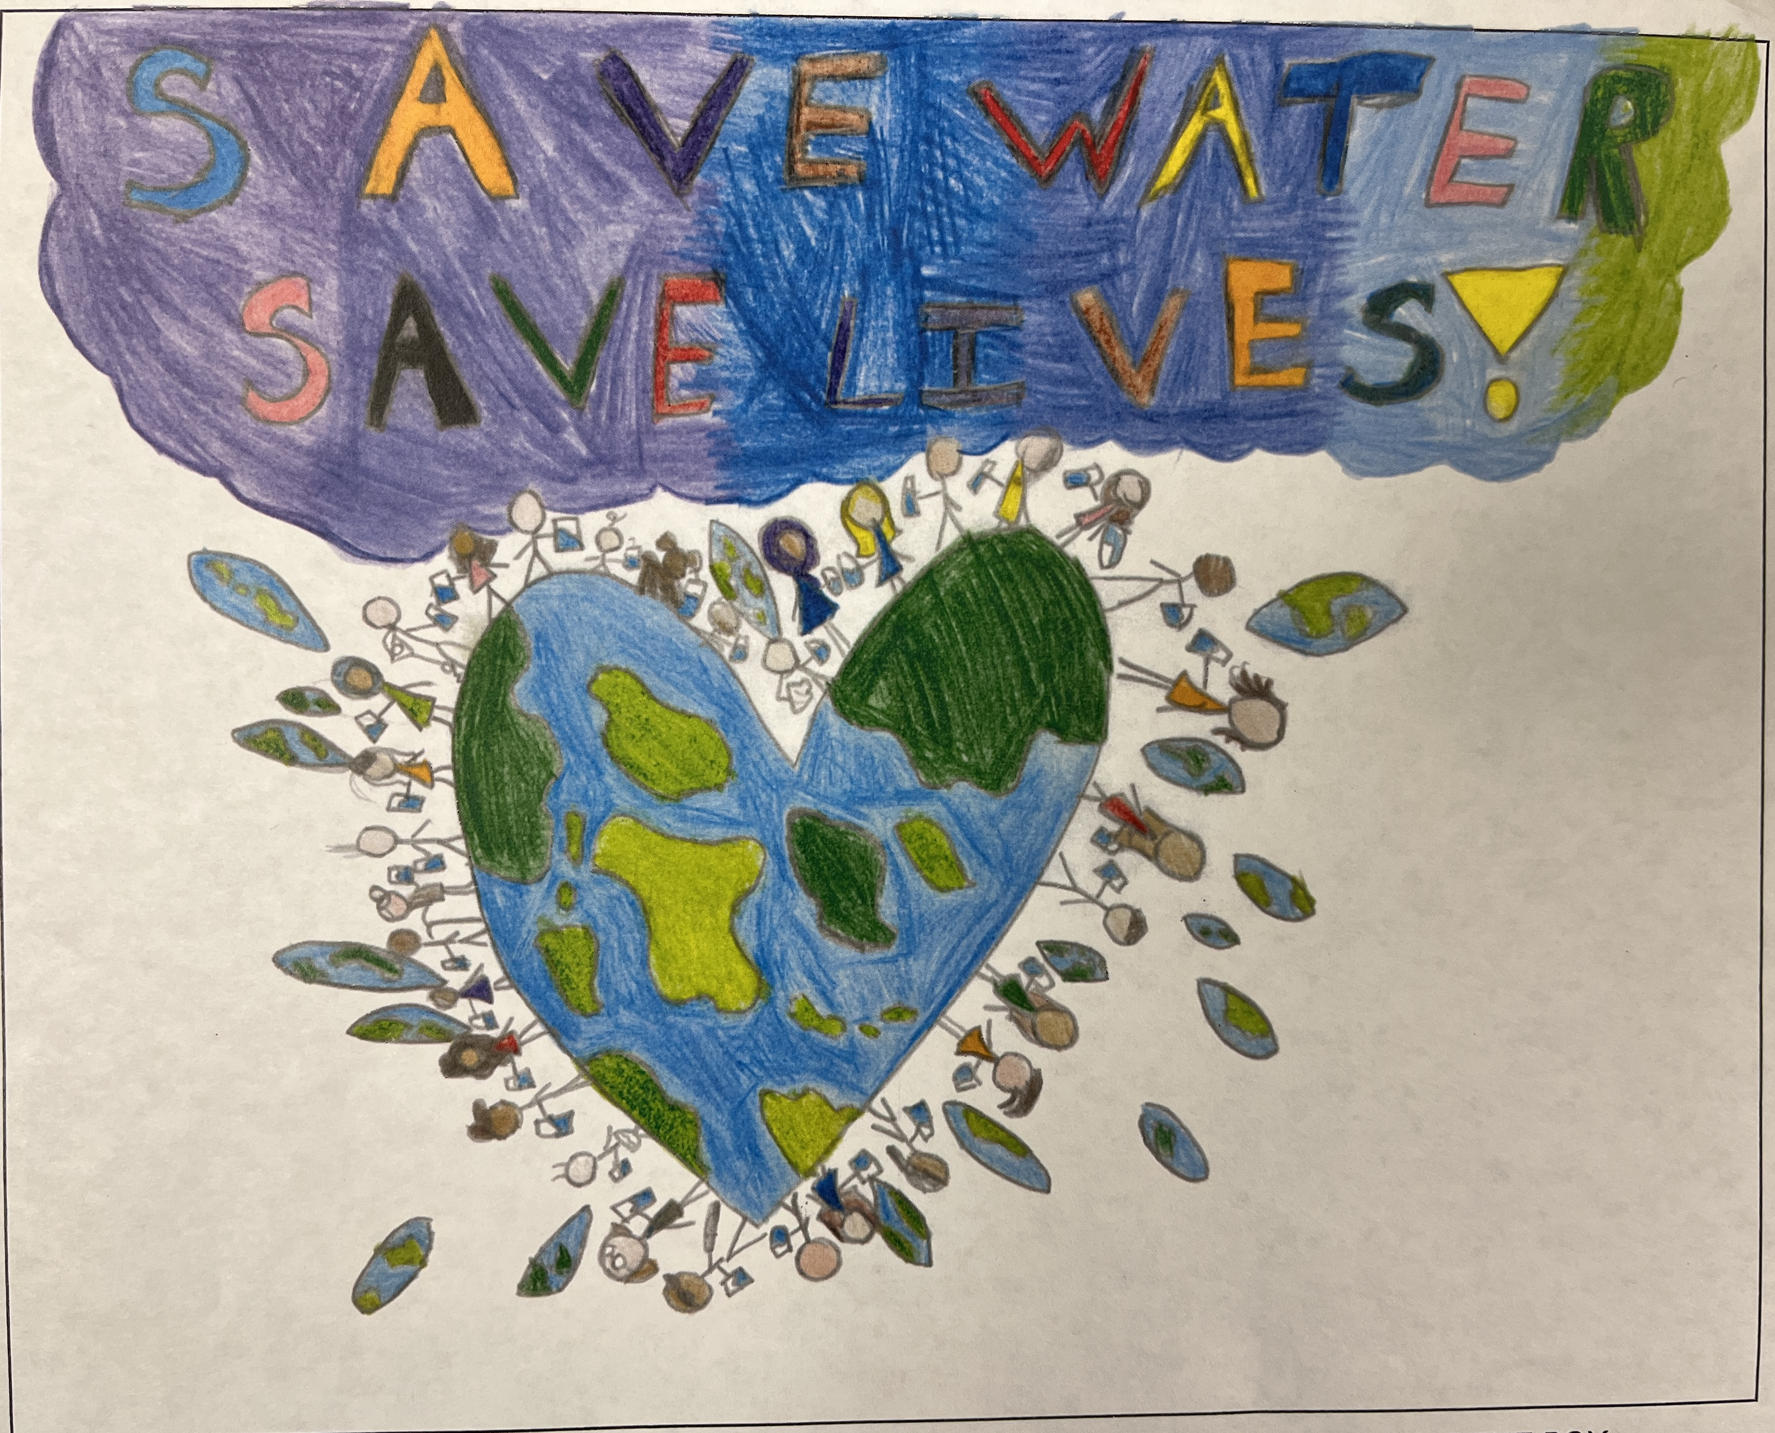
Poster Contest
2024 NCWA Water Awareness Poster Contest
Finalist voting in progress
Top three will be sent to NCWA for review and print in 2025 calendar
The winner art will be printed on the water bottles for the Rainbow Run
Notes:
Winners to be announced at Bonsall Elementary School

Slide 27
Public Communications
& Related Media Stories

Slide 28
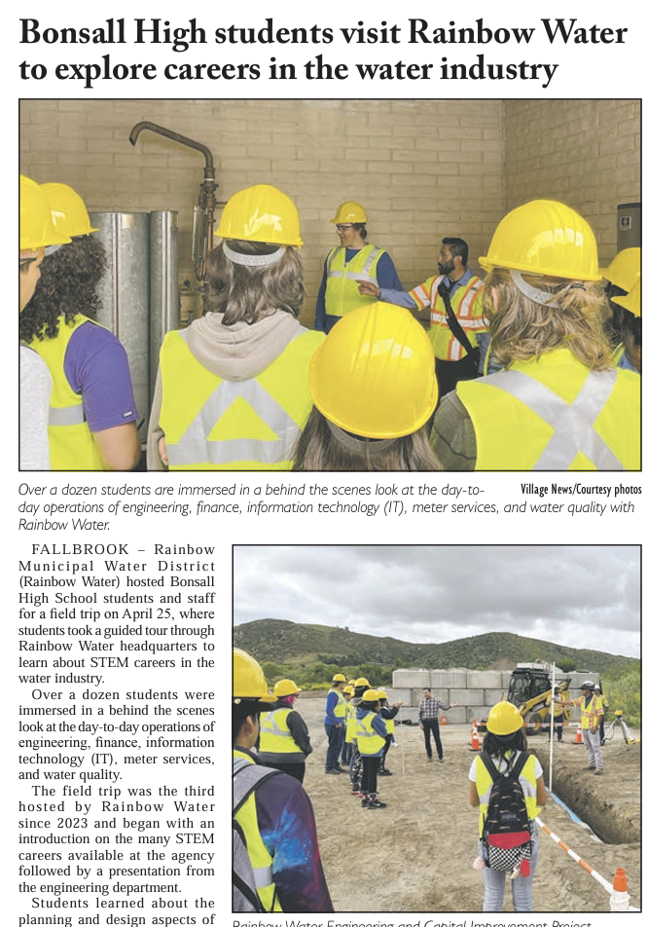
Village News
May 2
Regional Agriculture Program expands to San Diego and Riverside Counties
May 9
Bonsall High School Students Visit Rainbow Water to Explore Careers in the Water Industry
Notes:
Press release from Rancho Water on Regional CropSWAP Program expansion to cover Rainbow Water and Fallbrook.

Slide 29
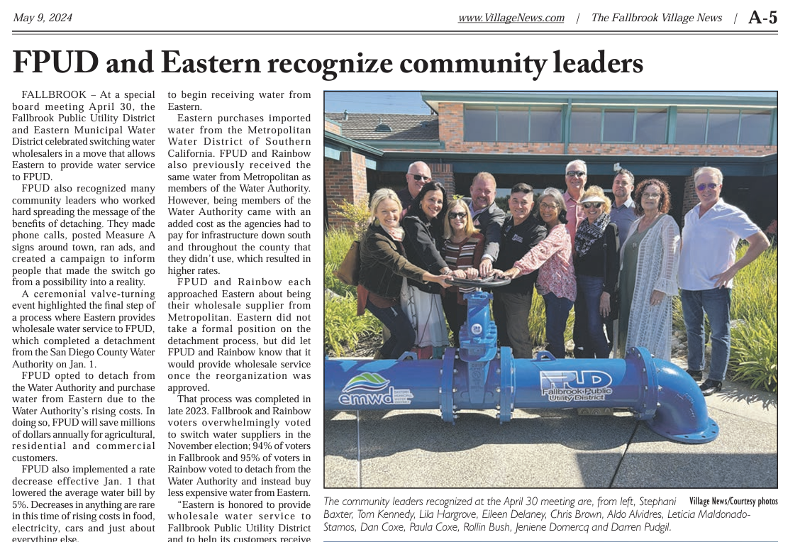
Village News
May 9
FPUD Recognizes Community Leaders
Notes:
At a special board meeting April 30, the Fallbrook Public Utility District and Eastern Municipal Water District celebrated switching water wholesalers in a move that allows Eastern to provide water service to FPUD. Community leaders recognized at the April 30 meeting are from left, Stephani Baxter, Tom Kennedy, Lila Hargrove, Eileen Delaney, Chris Brown, Aldo Alvidres, Leticia Maldonado- Stamos, Dan Coxe, Rollin Bush, Jeniene Domercq and Darren Pudgil

Slide 30
Agenda Items for Next Meeting June 18, 2024

